Slide 1
Indoor air pollution
dr. ir. Christophe Walgraeve
Prof. dr. ir. Herman Van Langenhove

Slide 2
LEARNING OBJECTIVES
Hazards of indoor air pollution
Different toxicants in indoor air, according to sources, settings and activities
Characteristics and issues relating to indoor air pollution in industrialized and developing countries
How to prevent exposure to indoor air contaminants

Slide 3
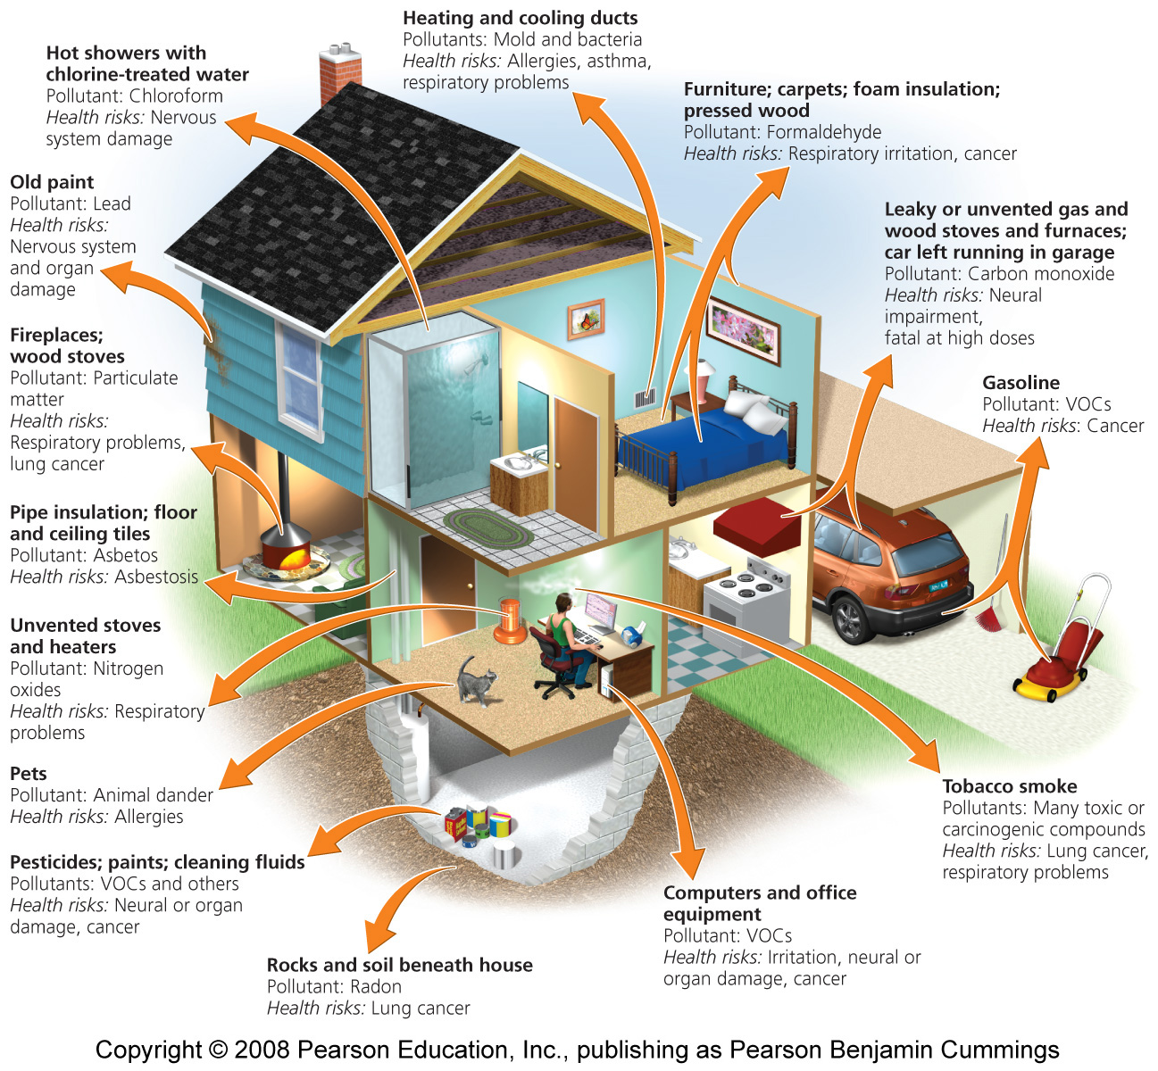

Slide 4
INDOOR AIR QUALITY
Indoor air quality is influenced by:
Outdoor air pollution: vehicles and industrial plants
Secondhand tobacco smoke
Fuels used for heating and cooking
Confined and poorly ventilated spaces
Overcrowded homes and insufficient living space
Customs, habits, traditions
Level of economic development:
Industrialized ≠ developing countries
Notes:
Indoor air quality is influenced by concentrations of outdoor air pollutants, indoor sources of pollution, characteristics of the building and the habits of the residents.
Indoor air pollution may arise from the use of open fires, unsafe fuels or combustion of biomass fuels, coal and kerosene. Gas stoves or badly installed wood-burning units with poor ventilation and maintenance can increase the indoor levels of carbon monoxide, nitrogen dioxide and particles.
Other pollutants not associated with fuel combustion include building materials such as asbestos and cement, wood preservatives and others.
Volatile organic compounds may be released by various sources including paints, glues, resins, polishing materials, perfumes, spray propellants and cleaning agents. Formaldehyde is a component of some household products and can irritate the eyes, nose and airways.

Slide 5
ADVERSE HEALTH EFFECTS OF AIR POLLUTANTS
Acute:
Irritation of the mucous membranes (eyes, nose, throat)
Cough, wheeze, chest tightness
Increased airway responsiveness to allergens
Increased incidence of acute respiratory illness:
"cold", pneumonia, otitis media
Tracheobronchitis
Exacerbation of asthma
Notes:
<<READ SLIDE.>>

Slide 6
ADVERSE HEALTH EFFECTS OF AIR POLLUTANTS
Chronic:
Long-term exposure decreases lung growth
Impairment of pulmonary function
Increased susceptibility to chronic obstructive lung diseases, including asthma
Other
Notes:
<<READ SLIDE.>>

Slide 7
Building Occupants
People living or working in particular indoor environments react to pollutants in different ways:
Some groups of people are particularly susceptible to indoor air pollution problems.
The symptoms reported by people in a particular environment vary.
In some cases, the symptoms reported result from factors other than air pollution.

Slide 8
Particularly Susceptible People
A person’s susceptibility to a particular air pollutant also depends on genetic factors, lifestyle, and age.
Sometimes a matter of concentration rather than susceptibility.
Older people and children are generally more sensitive.
People suffering from chronic lung or respiratory diseases are more susceptible.
Individuals who have suppressed immune systems.
Some people, when exposed to chemicals, develop multiple chemical sensitivity (MCS).

Slide 9
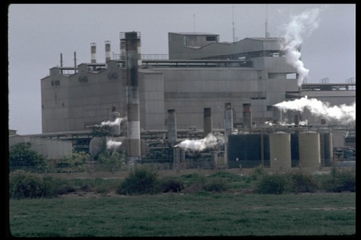
ENVIRONMENT AND POLLUTION
Indoor environments also reflect outdoor air quality
Industrial or agricultural activities
Treatment of industrial effluents and domestic residues
Traffic
Solid waste management
Cottage industries
Chemical incidents and spills
WHO
Notes:
The indoor environment also reflects outdoor air quality and pollution. Outdoor pollution primarily results from the combustion of fossil fuels by industrial plants and vehicles. This releases carbon monoxide, sulfur dioxide, particulate matter, nitrogen oxides, hydrocarbons and other pollutants. The characteristics of emissions and solid waste disposal may vary for each specific industry (e.g. smelting, paper production, refining and others).
Picture: WHO, J. Vizcarra. Environmental Air Pollution

Slide 10
Indoor air can mix with outside air by 3 mechanisms
Infiltration
natural ventilation
forced ventilation

Slide 11
Infiltration
natural air exchange that occurs between a building & its environment when doors & windows are closed
leakage through holes or openings in the building
pressure differentials inside & outside the building
temperature differentials inside & outside of building
in winter, warm air inside wants to rise → exits
through cracks in ceiling & draws in outside air
how fast wind is blowing

Slide 12
Natural ventilation
air exchange that occurs when windows or doors are opened to increase air circulation
Forced ventilation
mechanical air handling systems used to induce air exchange using fans & blowers

Slide 13
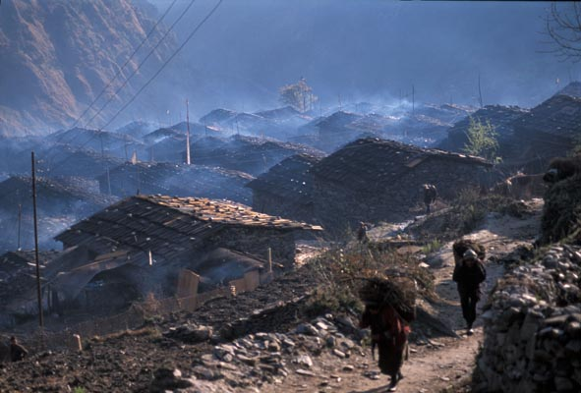
INDOOR AIR POLLUTION ALSO AFFECTS OUTDOOR AIR QUALITY
Nigel Bruce/ITDG
Notes:
Indoor smoke polluting the ambient air in a small village in Nepal.
Picture: Nigel Bruce/ITDG. Used with permission.

Slide 14
GLOBAL BURDEN OF DISEASE ATTRIBUTABLE TO SELECTED MAJOR RISK FACTORS
Underweight
Tobacco
Unsafe sex
Alcohol
Overweight
5% -
Water, sanitation and hygiene (5.5%)
Percentage of total burden (within region)
Solid fuel use (3.7 %)
Physical inactivity
Zinc deficiency
Tobacco
Alcohol
1% -
Overweight
Occupational risks
Unsafe sex
Occupational injuries
Ambient air
Ambient air
Lead
Water, sanitation and hygiene
Climate change
Lead
Developing countries
(high mortality)
Industrialized countries
Notes:
Household energy practices vary widely around the world, as does the resultant death toll due to indoor smoke. In high-mortality developing countries, indoor smoke is responsible for 3.7% of the overall disease burden, making it the most important risk factor after malnutrition (9%), unsafe sex (6%) and lack of safe water and adequate sanitation. In low-mortality developing countries, indoor smoke occupies the 8th rank and accounts for 1.9% of the disease burden. In contrast, in industrialized countries the impact of cooking and heating with solid fuels becomes negligible in relation to risk factors such as tobacco, high blood pressure and alcohol consumption. Notes taken from www.who.int/indoorair/info/en/briefing2.pdf
Refs:
Indoor air pollution in developing countries: a major environmental and public health challenge. Bulletin of the World Health Organization, 2000.
World Health Report 2002. Indoor Air Thematic Briefing 2 (www.who.int/indoorair/info/en/briefing2.pdf).
Additional information can be found at: www.who.int/indoorair/publications/en/

Slide 15
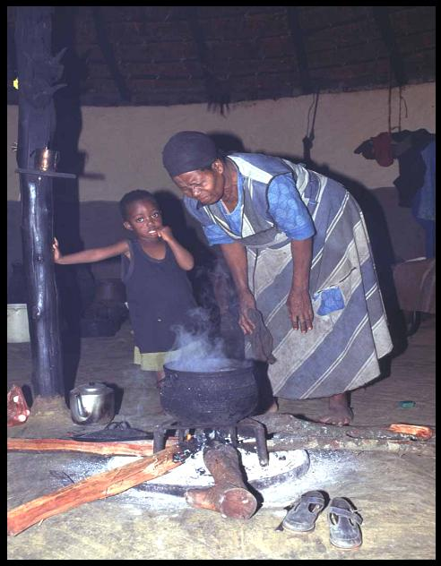
HOUSEHOLD ENERGY, IAP AND HEALTH
Dung
Wood
Agricultural residues
Charcoal Coal
3 billion people rely on solid fuels
Solid fuels comprise 10--15% of the total fuels used worldwide
Cooking and heating
levels indoor air pollution
Most concern: particulate matter and carbon monoxide
Women and children heavily exposed
Nigel Bruce/ITDG
Notes:
Some 3 billion people (half of the world’s population!) rely on solid fuels (e.g. dung, wood, agricultural residues, charcoal, coal) for their basic energy needs. Cooking and heating with solid fuels leads to high levels of indoor air pollution (IAP), a complex mix of health-damaging pollutants (e.g. particulate matter and carbon monoxide). Women and young children, who spend most time at home, experience the largest exposures and health burdens.
IAP = indoor air pollution
Picture: Nigel Bruce/ITDG. Used with permission.

Slide 16
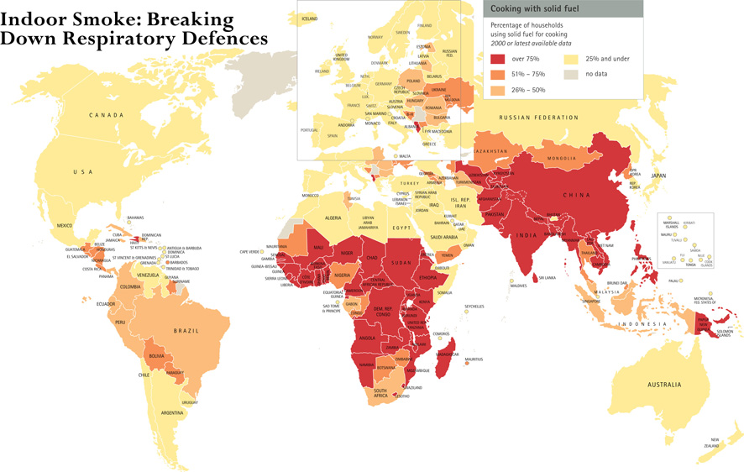
Gordon, WHO, 2004
Notes:
Cooking is central to our lives, yet the very act of cooking is a threat to children’s health and well-being. Half of the world’s population relies on solid fuels, such as dung, wood, crop waste or coal to meet their most basic energy needs. In most developing countries, these fuels are burned in open fires or rudimentary stoves that give off black smoke. Children, often carried on their mother’s back during cooking, are most exposed. The indoor smoke inhaled leads to pneumonia and other respiratory infections – the biggest killer of children under 5 years of age. Indoor air pollution is responsible for nearly half of the more than 2 million deaths each year that are caused by acute respiratory infections. Good ventilation and improved cooking stoves can dramatically reduce children’s exposure to smoke. Ultimately, making the transition to gas and electricity will save lives and reduce the physical toll on women and children from gathering wood, freeing time for education and development. This problem has been largely ignored by policy-makers.
Ref:
Gordon B et al. Inheriting the world, the Atlas on Children's Health and the Environment. Geneva, World Health Organization, 2004

Slide 17
INDOOR AIR POLLUTION LEVELS ARE VERY HIGH
Level of particulates in home using biofuel: >1000 µg/m³
(24 hr mean)
Can reach 10 000 µg/m³ PM₁₀ (if using an open fire)
EPA: 50 µg/m³ PM₁₀ annual mean
Women and young children have greatest exposure
Nigel Bruce/ITDG
Notes:
Standards and guidelines
US EPA standards are illustrated here. 150 µg/m³ PM₁₀ is the 24-hour 99% percentile value, thus it should be exceeded only on 1% of occasions. The recommended annual mean limit is 50 µg/m³ PM₁₀ (PM₁₀ are respirable particles ≤ 10 micrometre (µm) in diameter).
Levels of pollution in homes using biomass fuel
Numerous studies have shown that the levels of particulates are very high, with 24-hour means of around 1000 µg/m³ PM₁₀, and even exceeding 10 000 µg/m³ PM₁₀ when sampling is carried out during use of an open fire. It is reasonable to compare the EPA recommended annual mean limit of 50 µg/m³ PM₁₀ with the typical 24-hour mean for a home in which biomass fuel is used, of 1000 µg/m³ PM₁₀ quoted, as this latter value is typical of the level every day (thus, annual mean levels can be expected to be around 1000 µg/m³ PM₁₀). This comparison shows that average pollution levels are around 20 times the EPA recommended limit.
Ambient pollution and personal exposure
Two important components are (a) the level in the home, and (b) the length of time for which each person in the home is exposed to that level. We know that typically women and young children (until they can walk), and girls (as they learn kitchen skills) are often exposed for at least 3–5 hours a day, often more. In some communities, and where it is cold, exposure will be for a much longer period each day.
Ref:
Addressing the links between indoor air pollution, household energy and human health. Based on the WHO-USAID Consultation on the Health Impact of Household Energy in Developing Countries (Meeting report).Geneva, World Health Organization, 2002.
Additional information can be found at: www.who.int/indoorair/publications/en/
Picture: Courtesy of Nigel Bruce/ITDG. Used with permission.

Slide 18
WHAT INTERVENTIONS ARE AVAILABLE TO REDUCE INDOOR AIR POLLUTION FROM SOLID FUELS?
Source of pollution
Home environment
User behaviour
- Improved stoves
- Cleaner fuels (kerosene, gas, electricity)
-Hoods and chimneys
-Windows, ventilation holes, eaves spaces
-Separate kitchen
- Fuel drying
- Use of pot lids
- Good maintenance
- Keeping children away from smoke
Notes:
<<READ SLIDE>>
Solid fuels comprise only 10–15% of fuel used.
Nearly one half of the world’s population uses solid fuels for cooking and heating homes.
- 2 billion people are exposed to particulate matter (PM) and gases at levels up to 100 times higher than in ambient (outdoor) air.
- Women and children are most exposed: levels may be 10 to 100 times above safety standards for ambient air.
Combustion produces hundreds of toxic chemicals that concentrate inside homes.
Biomass (wood, agricultural produce, straw and dung) produces:
- a wide variety of liquids, suspended particles, gases and mixtures.
Coal produces:
- Polycyclic aromatic hydrocarbons (PAHs), benzene, formaldehyde, sulfur, heavy metals and fluoride.
These pollutants affect the most vulnerable populations, women of childbearing age, infants and children in the poorest circumstances.
Ref:
Air pollution: what a paediatrician needs to know. Leaflet published by the World Health Organization in collaboration with the International Pediatric Association, 2003.
Additional information on these references can be found at: www.who.int/indoorair/publications/en/

Slide 19
COMBUSTION PRODUCTS
Sources
Gas stoves and appliances
Wood and coal stoves
Gas and propane engines
Fireplaces
Tobacco smoke
Candles and incense
Mosquito coils
Combustion products
Carbon monoxide (CO)
Nitrogen dioxide (NO₂)
Sulfur dioxide (SO₂)
Nitrogenated compounds (NO_{x})
Particulate matter (PM)
Notes:
A large number of combustion products originate from various different sources. The main ones are listed here.
<<READ SLIDE.>>

Slide 21
CARBON MONOXIDE: THE "SILENT KILLER" A COMMON CAUSE OF ACUTE AND LETHAL POISONING
Colourless, odourless gas formed by incomplete burning of carbon-based fuels
CO’s affinity for Hb is 240–270 times greater than oxygen
Fetal Hb has higher affinity for CO
CO causes a leftward shift of the
oxyhaemoglobin (OHb) dissociation curve
Intoxication results in tissue hypoxia
Multiple organ systems are affected
www.cdc.gov/nceh/airpollution/carbonmonoxide/checklist.htm
Notes:
CO is a colourless, odourless gas formed by incomplete burning of carbon-based fuels.
CO’s affinity for haemoglobin (Hb) is 240–270 times greater than that of oxygen:
- it decreases the capacity of Hb for carrying oxygen.
Fetal Hb has a higher affinity for CO.
CO causes a leftward shift of the oxyhaemoglobin dissociation curve:
- it decreases oxygen delivery to tissues.
Intoxication results in tissue hypoxia.
Multiple organ systems are affected:
- Mainly systems with high metabolic rates;
- CNS, cardiovascular system.
Exposure to carbon monoxide reduces the blood's ability to carry oxygen. The chemical is odourless and some of the symptoms of exposure are similar to those of common illnesses. This is particularly dangerous because carbon monoxide's deadly effects may not be recognized until it is too late to take action.
Exposure to carbon monoxide is particularly dangerous to unborn babies, infants and people with anaemia or a history of heart disease. Breathing low levels of the chemical can cause fatigue and increase chest pain in people with chronic heart disease. Breathing higher levels of carbon monoxide causes symptoms such as headaches, dizziness and weakness in healthy people. Carbon monoxide also causes sleepiness, nausea, vomiting, confusion and disorientation. At very high levels it causes loss of consciousness and death. Poisoning may have irreversible sequelae.
These notes are taken from the US EPA website www.epa.gov/iaq/co.html
Hb = haemoglobin
COHb = carboxyhaemoglobin
Refs:
Carbon monoxide. In: Pediatric Environmental Health, 2nd ed. Etzel RA Ed. Elk Grove Village, IL: American Academy of Pediatrics. 2003.
Figure: www.cdc.gov/nceh/airpollution/carbonmonoxide/checklist.htm

Slide 22
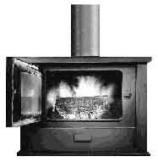
CARBON MONOXIDE (CO): SOURCES
Gas, kerosene, wood stoves and coal
Fires, fireplaces, furnaces
Leaking chimneys and vents
Room and water heaters
Vehicle exhaust in closed garage
Tobacco smoke
Any place where combustion is incomplete
EPA
Notes:
Incomplete oxidation during combustion in gas ranges and unvented gas or kerosene heaters may cause high concentrations of CO in indoor air. Worn or poorly adjusted and maintained combustion devices (e.g. boilers and furnaces) can be significant sources, especially if the fuel is of an unsuitable size, or if the system is blocked, or leaking. Car, truck, or bus exhaust from attached garages, nearby roads, or parking areas can also be a source. CO is one of the components of secondhand tobacco smoke.
Picture: www.epa.nsw.gov.au/woodsmoke/heateruse.htm

Slide 23
www.firstalert.com/index.asp?pageid=82
Notes:
In a a single-family house in the industrialized world, CO can come from many sources.
Figure: www.firstalert.com/index.asp?pageid=82, Used with Copyright permission.

Slide 24
CARBON MONOXIDE POISONING CAN KILL
Symptoms:
Headache, dizziness, fatigue, dyspnoea
Nausea, vomiting
Irritability
Sleepiness, confusion, disorientation
Unconsciousness, coma
Death
Delayed neuropsychological sequelae (in survivors)
Increasing COHb
Notes:
The route of exposure is through inhalation. Unintentional exposure to carbon monoxide (CO) can be attributed to smoke inhalation from inadequately vented combustion appliances, and from vehicles and tobacco smoke.
The clinical features of CO poisoning are highly variable and symptoms vary from mild to very severe. Acute effects are due to the formation of carboxyhaemoglobin in the blood, which inhibits oxygen intake. At moderate concentrations, angina, impaired vision, and reduced brain function may result. At higher concentrations, exposure to CO can be fatal. Delayed neuropsychological sequelae have been reported in adults and children; these usually occur 3 to 240 days following exposure and are estimated to occur in 10 to 30% of victims.
Ref:
California Poison Control System. Poisoning and drug overdose. Olson ed. Appleton and Lange, 1999.
Carbon monoxide. In: Pediatric Environmental Health, 2nd ed. Etzel RA Ed. Elk Grove Village, IL: American Academy of Pediatrics. 2003.
Hon KLet al. Neurologic and radiologic manifestations of three girls surviving acute carbon monoxide poisoning. J Child Neurol. 2006 Sep;21(9):737-41.
We report the neurologic and radiologic manifestations of three adolescent girls with acute carbon monoxide poisoning. The girls were found collapsed and unconscious in a bathroom where liquid petroleum gas was being used as heating fuel. As hyperbaric oxygen therapy was not available locally, they only received oxygen supplementation via nasal cannula (4 L/minute) as treatment in the first 2 days. On transfer to a tertiary center in Hong Kong, evolving neurologic manifestations of visual acuity and field deficits, confusion, and focal motor weaknesses were observed. Focal infarctions were evident in cerebral computed tomography in one patient and cortical lesions on magnetic resonance imaging in all three patients. [18F]Fluorodeoxyglucose (FDG) positron emission tomography (PET) revealed additional decreased metabolism in the basal ganglia in two patients, which was typical of carbon monoxide poisoning. The neurologic deficits resolved completely at 3 weeks after the exposure, but psychologic symptoms succeeded. This report serves to alert clinicians to the varied neuro-ophthalmologic manifestations and psychologic impairment even with the same duration of carbon monoxide poisoning. PET might be more sensitive in detecting
<<READ SLIDE.>>

Slide 25
PREVENTION OF EXPOSURE TO CO
Keep fuel-burning appliances in good working condition
Check heating systems, chimneys and vents regularly
Never burn charcoal indoors
Never leave a car running in a closed garage
Consider CO detectors
Notes:
Prevention is the key to avoiding carbon monoxide poisoning.
Primary prevention of carbon monoxide (CO) poisoning requires limiting exposure to known sources. Proper installation, maintenance, and use of combustion appliances can help to reduce exposure to CO.
The US Environmental Protection Agency (EPA) has set harm levels of:
50 ppm (8-hour average)
75 ppm (4-hour average)
125 ppm (1-hour average).
Exposure to these levels can lead to COHb levels of 5 to 10% and cause significant symptoms in sensitive individuals. The current US air quality standards for CO, intended to keep COHb below 2.1%, recommend levels of not more than 9 parts per million (ppm) for 8 hours and 35 ppm for 1 hour for outdoor air. No standards for CO have been agreed for indoor air.
Smoke and CO detectors may provide early warning and prevent unintentional CO-related deaths. They should, however, be in good working condition and should not substitute for other prevention measures (cleaning the chimney, etc.)
For more information on CO detectors, go to: www.epa.gov/iaq/pubs/coftsht.html
COHb = carboxyhaemoglobin
Ref:
www.pinefire-85.org/Fire_safety_pages/CARBON_MONOXIDE/carbon_monoxide.html

Slide 27
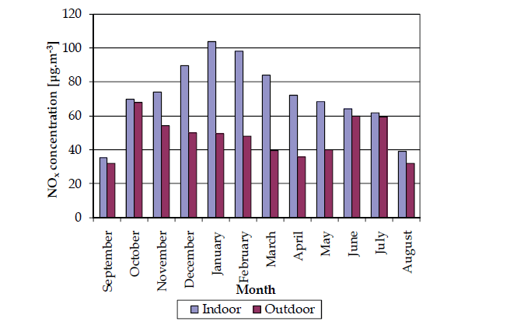
Notes:
Nitrogen monoxide (NO) and nitrogen dioxide (NO2) are gases produced by hightemperature
combustion through reactions between nitrogen and oxygen. Both nitrogen in
fuel and nitrogen in the air can participate in the reactions. Formation of NO can be
followed by further oxidation into NO2 in the atmosphere. NO2 is the most toxic of the
nitrogen oxides (grouped generically as NOx) and it is very important from the health point
of view. Emissions of nitrogen oxides have generally increased, a fact which has resulted in
a lot of studies dealing with nitrogen oxides exposure, particularly over the last 15 years.
Measurements of NO2 were carried out in residential and industrial premises over 2-day
periods both in winter and summer. Personal exposures were found to vary substantially
among the 43 respondents, ranging from 10.2 - 87.5 ppb with a mean of 43.7 ± 16 ppb in
winter and 23.6 ± 7.8 ppb in summer. The results also showed that the season of the year,
house size and outdoor occupation could significantly influence exposure as well as factors
such as the type of fuel used and the ambient air quality level. Personal exposure to NO2
was significantly greater in winter than in summer, and respondents living in smaller
houses and/or having outdoor occupations were exposed to higher NO2 levels (

Slide 29
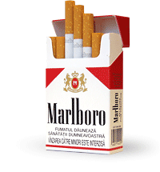
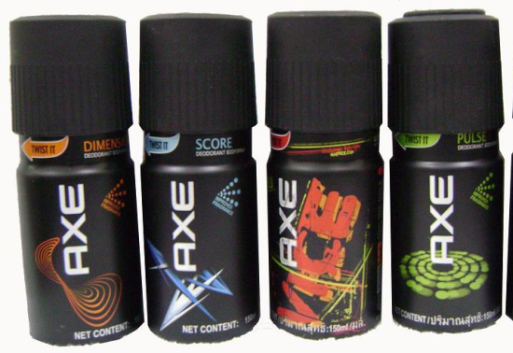
Notes:
OP de vraag hoe jullie worden bloottgesteld aan VOC? zullen de meeste onder jullie spontaan verkeersemissies in de buitelicht denken. In de westerse wereld spenderen we gemiddelg gesproken 80 % van ons leven in een binnenomgeving

Slide 30
Volatile Organic Compounds (VOCs)
The most diverse group of indoor air pollutants
Released by everything from plastics and oils to perfumes and paints
Ex. formaldehyde, which leaks from pressed wood and insulation, irritates mucous membranes and induces skin allergies
Ex. pesticides, which are found indoors more often than outdoors due to seepage
Most VOCs are released in very small amounts
Unclear health effects due to low concentrations

Slide 31
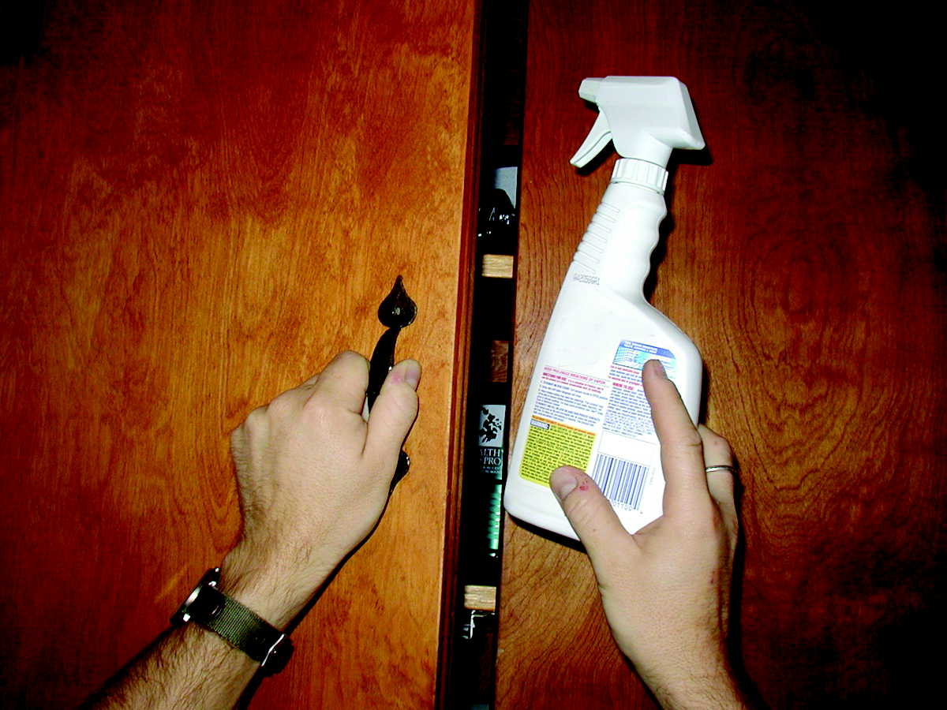
VOLATILE ORGANIC COMPOUNDS
Alkanes, aromatic hydrocarbons, alcohols, aldehydes, ketones
Sources:
Solvents, fabric softeners, deodorizers and cleaning products
Paints, glues, resins, waxes and polishing materials
Spray propellants, dry cleaning fluids
Pens and markers
Binders and plasticizers
Cosmetics: hair sprays, perfumes
www.epa.gov/oppfead1/cb/10_tips/
Notes:
Organic chemicals are widely used as ingredients in household products including paints, varnishes, wax, cosmetics, degreasing agents, wood preservatives, aerosol sprays, cleansers, disinfectants, moth repellents, air fresheners and hobby products. Fuels are also made up of organic chemicals.
All of these products can release organic compounds while they are being used, and, to some degree, when they are stored.
The average levels of several organic compounds in indoor air are 2–5 times higher than in outdoor air. During certain activities, such as paint-stripping, and for several hours immediately afterwards, levels may be 1000 times higher than outdoor levels.
These notes are taken from the US EPA Website www.epa.gov/iaq/voc.html
Picture: www.epa.gov/oppfead1/cb/10_tips/

Slide 32
FORMALDEHYDE
Sources: differ according to country
Developing countries
Use of solid fuels indoors
Mosquito coils
Furniture (pressed wood)
Industrialized countries
Household cleaners and deodorizers
Glues and resins
Tobacco smoke
Carpeting
Furniture and dyed materials
Pressed wood products
Urea formaldehyde insulating foam (UFFI)
Others
Notes:
Ref:
www.epa.gov/iaq/formalde.html

Slide 33
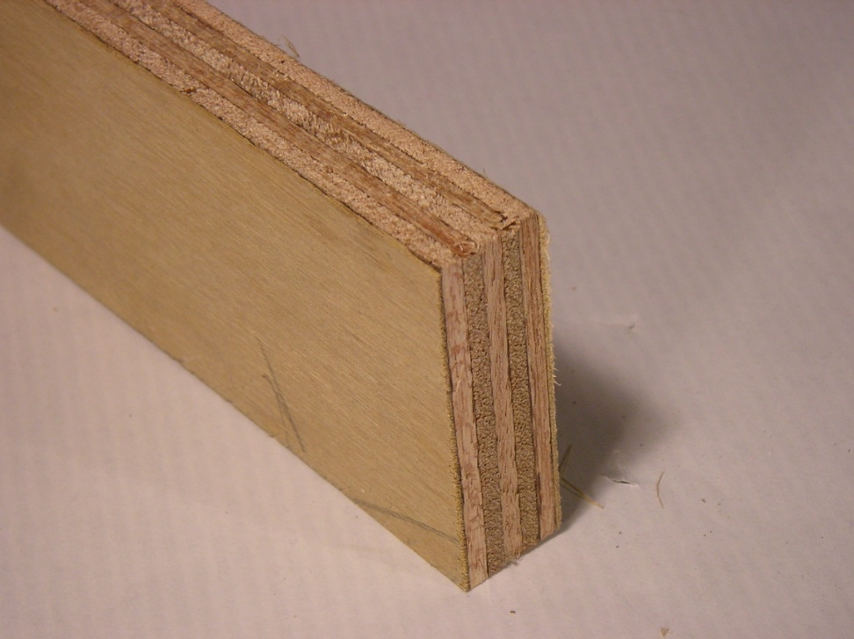
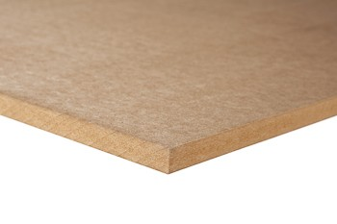
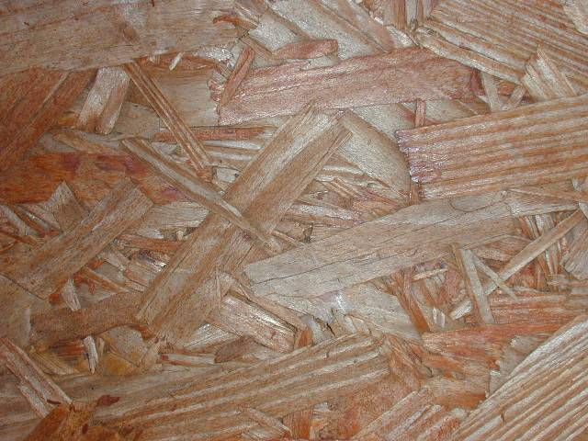
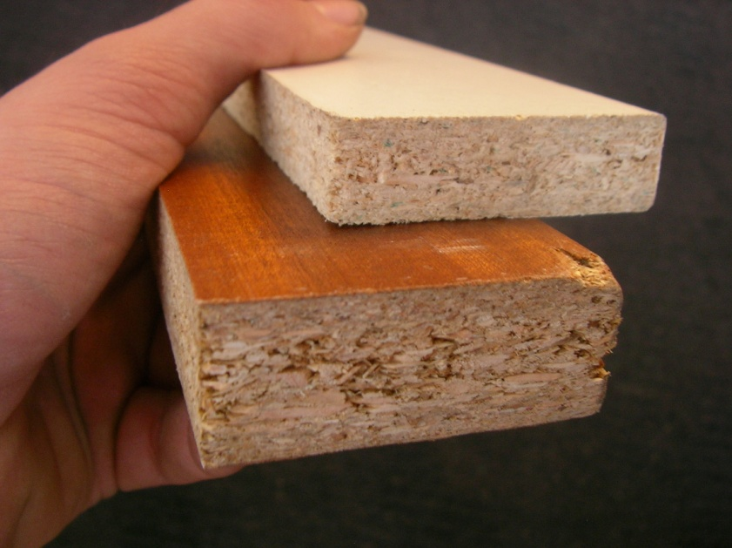
Plywood
MDF
particleboard
Notes:
Formaldehyde is an important chemical used widely by industry to manufacture building materials and numerous household products. It is also a by-product of combustion and certain other natural processes. Thus, it may be present in substantial concentrations both indoors and outdoors.
Sources of formaldehyde in the home include building materials, smoking, household products, and the use of unvented, fuel-burning appliances, like gas stoves or kerosene space heaters. Formaldehyde, by itself or in combination with other chemicals, serves a number of purposes in manufactured products. For example, it is used to add permanent-press qualities to clothing and draperies, as a component of glues and adhesives, and as a preservative in some paints and coating products.
In homes, the most significant sources of formaldehyde are likely to be pressed wood products made using adhesives that contain urea-formaldehyde (UF) resins. Pressed wood products made for indoor use include: particleboard (used as subflooring and shelving and in cabinetry and furniture); hardwood plywood paneling (used for decorative wall covering and used in cabinets and furniture); and medium density fiberboard (used for drawer fronts, cabinets, and furniture tops). Medium density fiberboard contains a higher resin-to-wood ratio than any other UF pressed wood product and is generally recognized as being the highest formaldehyde-emitting pressed wood product.
Other pressed wood products, such as softwood plywood and flake or oriented strandboard, are produced for exterior construction use and contain the dark, or red/black-colored phenol-formaldehyde (PF) resin. Although formaldehyde is present in both types of resins, pressed woods that contain PF resin generally emit formaldehyde at considerably lower rates than those containing UF resin.
The rate at which products like pressed wood or textiles release formaldehyde can change. Formaldehyde emissions will generally decrease as products age. When the products are new, high indoor temperatures or humidity can cause increased release of formaldehyde from these products.
During the 1970s, many homeowners had urea-formaldehyde foam insulation (UFFI) installed in the wall cavities of their homes as an energy conservation measure. However, many of these homes were found to have relatively high indoor concentrations of formaldehyde soon after the UFFI installation. Few homes are now being insulated with this product. Studies show that formaldehyde emissions from UFFI decline with time; therefore, homes in which UFFI was installed many years ago are unlikely to have high levels of formaldehyde now.

Slide 34
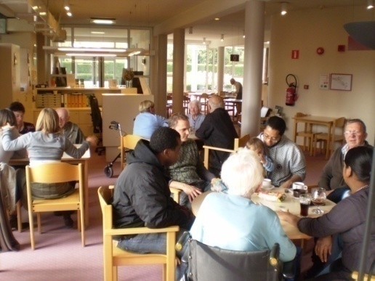
Indoor Concentrations (µg/m³)
Notes:
Deze uptake rates werden aangewend om de concentratieniveaus van de vocs op te volgen in tal van rusthuisbewonerskamers. Hier han u de resultaten zien. Verschillende componenten zijn aanwezig in verschillende concentraties. Waar voor Limoneen de gemiddlde concentrayties in 75% van de gevallen lager 50 µg/m³ ligt is de concentratie voor benzeen in 75% van de gevallen lager dan 2µg/m³

Slide 35
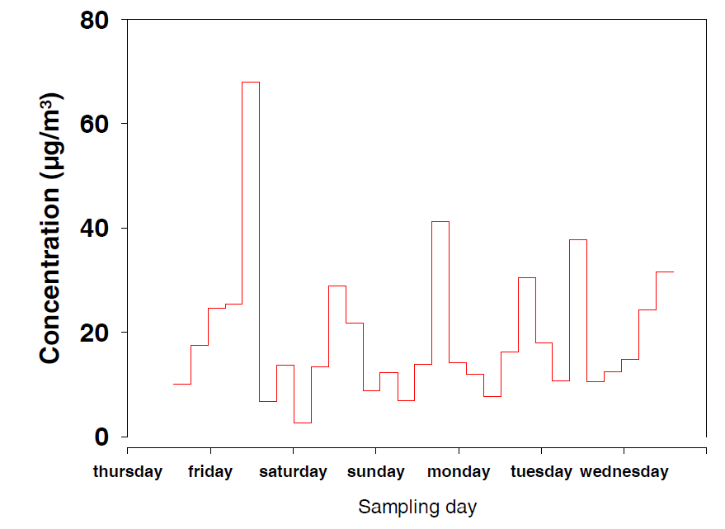
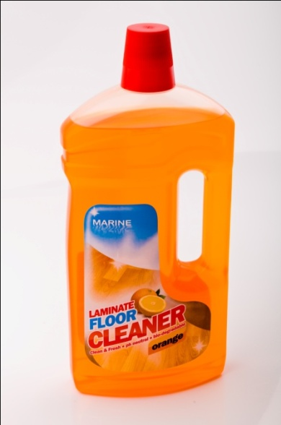
Notes:
Hier ziet u het resultaat van de actieve monstername voor de component limoneen. Limoneen is een geurstof aanwezig in schoonmaakproducten. U ziet dat deze concentraties sterk schommelen. De piekconcentraties zijn te wijten aan schoonmaak in de ruimte. Uit deze concentraties kan een gemiddelde concentratie worden berekend. Deze concentratie kan samen met de bemonsteringstijd t en de massa van de component op het passief monsternameapparraat aangewend worden voor de berekening van de uptake rate. Het zelfde proces kan herhaald worden voor de overige componenten

Slide 36
VOLATILE ORGANIC COMPOUNDS: HEALTH EFFECTS
Acute:
Irritation of eyes and respiratory tract
General: headache, dizziness, loss of coordination, nausea, visual disorders
Allergic reactions, including asthma and rhinitis
Chronic:
Damage to liver, kidney, blood system and
central nervous system (CNS)
Some may cause cancer in humans (formaldehyde)
Notes:
Volatile organic compounds (VOC) vary greatly in their health effects: some are highly toxic, whereas some have no known effects on health.
As with other pollutants, the extent and nature of the effects on health will depend on many factors including level of exposure and duration of exposure.
The immediate symptoms experienced after exposure to VOC may include eye, nose and throat irritation; headaches; loss of coordination; nausea; dizziness; and visual disorders. Memory impairment and damage to liver, kidneys and central nervous system (CNS) may also occur. Little is yet known about what effects on health occur from exposure to the levels of organics usually found in homes. Many organic compounds are known to cause cancer in animals; some are suspected of causing, or are known to cause, cancer in humans.
Steps to reduce exposure
Use household products according to manufacturer's directions.
Make sure to provide plenty of fresh air when using these products.
Throw away unused or little-used containers safely; buy in quantities that can soon be used.
Keep out of reach of children and pets.
Never mix household care products unless directed on the label.
These notes are taken from the US EPA website www.epa.gov/iaq/voc.html

Slide 37
SICK BUILDING SYNDROME
Symptoms:
Headache
Irritation of eyes, nose or throat
Dry cough
Dry or itchy skin
Difficulty in concentrating
Fatigue
Sensitivity to odours
Solutions:
Remove source of pollutant
Increase ventilation
Air cleaning: filters
Education and communication
Notes:
<<READ SLIDE.>>

Slide 39
PESTICIDES
Spraying pesticides at home / school:
Higher concentrations near the floor
Persistence in some surfaces (carpets, soft toys)
Overuse and misuse
Children’s behaviour and inhalation of pesticides
Crawling
Playing close to the floor
Plush toys
Hand-to-mouth
Object-to-mouth
Notes:
Spraying pesticides in the home results in increased risks to children because of higher concentrations near the floor and persistence of insecticides in carpets and soft toys. The typical activities of young children also contribute to their higher exposure.
Pesticides are covered extensively in a separate module.
Ref:
Reigart R et al. Pesticides in children. Pediatric Clinics of North America, 2001, 48:1185.
Children are exposed to a wide range of pesticides, including insecticides, herbicides, fungicides and rodenticides. They differ from adults in their exposures and responses to exposures. Acute and chronic toxicity are discussed, and important chronic effects, such as carcinogenesis, endocrine disruption, and neurodevelopmental effects are reviewed. Laws and regulations are also discussed. Recommendations are made to pediatricians regarding treatment and advising families regarding avoidance of pesticide exposures and their effects.

Slide 40
PESTICIDES: INSECTICIDES
Classes commonly used for insect control indoors:
Pyrethroids: allergenic, CNS toxicity at high levels
Cholinesterase inhibitors: neurotoxicants, neurodevelopmental toxicants
Insect repellents (DEET)
Mosquito coils
Health effects:
Acute poisoning
Allergic and general symptoms
Notes:
<<READ SLIDE>>
Classes of insecticide commonly used for insect control indoors include the following:
Pyrethroids: these are very allergenic and can lead to central nervous system (CNS) toxicity at high levels of exposure.
Cholinesterase inhibitors: these are neurotoxicants and neurodevelopmental toxicants (organophosphosphates, carbamates).
Insect repellents: diethyltoluamide (DEET).
Mosquito coils.
The effects on health of exposure to these insecticides include:
acute poisoning usually related to accidental ingestion in children;
allergic and general symptoms
– headache, nausea, vomiting;
– cough, rhinitis, bronchitis, asthma and other allergic symptoms.

Slide 41
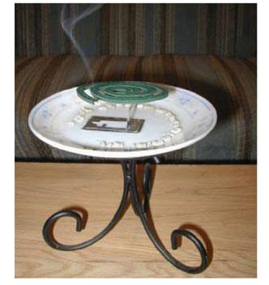
MOSQUITO COILS
Household use in Africa, Asia, South America
Major active ingredient – pyrethrins
Long-term exposures linked to asthma
and wheezing
ehp.niehs.nih.gov/members/2003/6177/6177.html
Notes:
Mosquito coils may represent a serious potential threat to children’s health. Prolonged use has been associated with increased incidences of asthma and persistent wheezing in children. Although the active ingredient is usually small amounts of pyrethrins (considered a low-toxicity insecticide), over 99% of the mass of the coil is so-called “inert” ingredients. When analysed, the smoke from coils was found to be entirely composed of respirable-sized particles, some quite small. The particles contain numerous polycyclic aromatic hydrocarbons (PAH) and carbonyl compounds including formaldehyde. One recent analysis found that the burning of one mosquito coil for 2 hours allowed a steady state of particulate matter to develop, and that the PM2.5 produced was the equivalent of that from burning 75–137 cigarettes (the formaldehyde produced was the equivalent of 51 cigarettes).
Ref:
Liu W et al. Mosquito coil emissions and health implications. Environ Health Perspect, 2003, 111:1454-60.
Burning mosquito coils indoors generates smoke that can control mosquitoes effectively. This practice is currently used in numerous households in Africa, Asia and South America. However, the smoke may contain pollutants of health concern. We conducted the present study to characterize the emissions from four common brands of mosquito coils from China and two common brands from Malaysia. We used mass balance equations to determine emission rates of fine particles (particulate matter < 2.5 µm in diameter; PM2.5), polycyclic aromatic hydrocarbons (PAHs), aldehydes and ketones. Having applied these measured emission rates to predict indoor concentrations under realistic room conditions, we found that pollutant concentrations resulting from burning mosquito coils could substantially exceed health-based air quality standards or guidelines. Under the same combustion conditions, the tested Malaysian mosquito coils generated more measured pollutants than did the tested Chinese mosquito coils. We also identified a large suite of volatile organic compounds, including carcinogens and suspected carcinogens, in the coil smoke. In a set of experiments conducted in a room, we examined the size distribution of particulate matter contained in the coil smoke and found that the particles were ultrafine and fine. The findings from the present study suggest that exposure to the smoke of mosquito coils similar to the tested ones can pose significant acute and chronic health risks. For example, burning one mosquito coil would release the same amount of PM2.5 mass as burning 75–137 cigarettes. The emission of formaldehyde from burning one coil can be as high as that released from burning 51 cigarettes.
Picture: ehp.niehs.nih.gov/members/2003/6177/6177.html. NIEHS

Slide 43
Environmental Tabacco smoke

Slide 44
Mainstream smoke
Exhaled smoke
Sidestream smoke
Emitted from burning cigarette
Environmental tobacco smoke (ETS) = second-hand smoke
Combination of mainstream and sidestream smoke. Contains more than 4000 particle components and gases, over 50 of which are known carcinogens. ETS may cause 17% of lung cancers of nonsmokers.
Concentrations
One pack of cigarettes ≈ 20 μg m⁻³ of particles in room over 24 hours. Near smoker, concentrations 500-1000 μg m⁻³

Slide 45
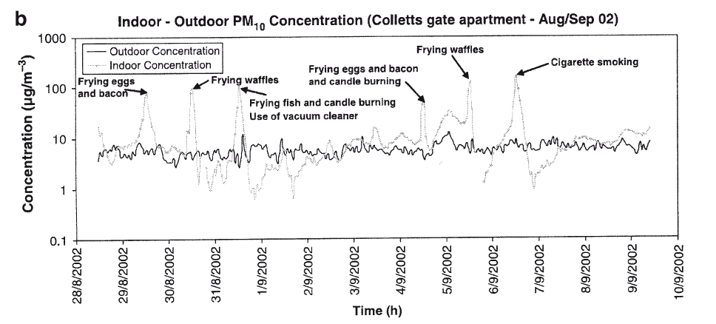

Slide 47
RADON
Radon 222 is a radioactive gas released from soil and rocks during natural decay of Uranium and Thorium
Considered second leading cause of lung cancer, may enhance risk of cancer in smokers
Geology of the area can predict potential high levels in soil and water
Radon concentrations indoors depend on construction aspects: building materials; cracks or pores in concrete floor and walls; floor-wall joints; loose pipe penetration; air pressure of a house lower than the surrounding soil, and others
Highest level in basements and ground floor
Exposure can also be from water vapor during showering, cooking
Notes:
Radon is a radioactive gas that comes from the soil. Exposure to radon gas is the second leading cause of lung cancer (after smoking). Scientific evidence suggests that 3-14% of lung cancers are due to exposure to indoor radon. Radon is produced from the natural breakdown of the uranium found in most rocks and soils. As it further breaks down, radon emits atomic particles. These particles are in the air we breathe. Once inhaled, they can be deposited in our lungs. The energy associated with these particles can alter cell DNA, thus increasing the risk of lung cancer.
Radon usually does not present a health risk outdoors because it is diluted in the open air. Radon can, however, build up to dangerous levels inside a house. Radon can enter your new house through cracks or openings in the foundation. The differences in air pressure between the inside of a building and the soil around it also play an important role in radon entry. If the air pressure of a house is greater than the soil beneath it, radon will remain outside. However, if the air pressure of a house is lower than the surrounding soil (which is usually the case), the house will act as a vacuum, sucking radon gas inside. Because radon comes from the soil, the geology of an area can help to predict the potential for elevated indoor radon levels.
Reference:
World Health Organization. WHO Handbook on Indoor Radon: A Public Health Perspective .WHO, Geneva, 2009. Available at www.who.int/ionizing_radiation/env/radon/en/index1.html - accessed December 2009

Slide 48
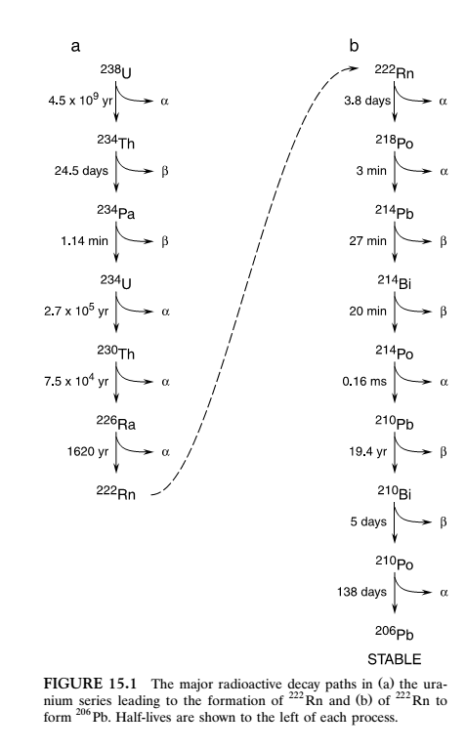
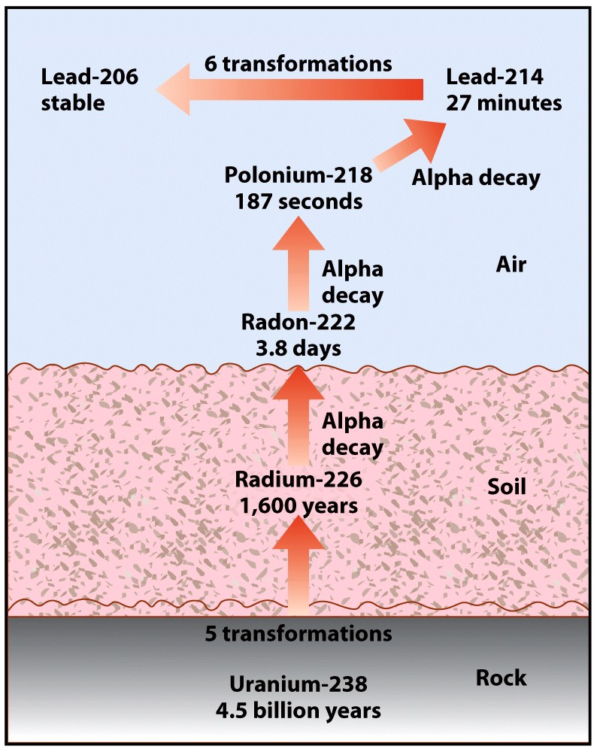

Slide 49
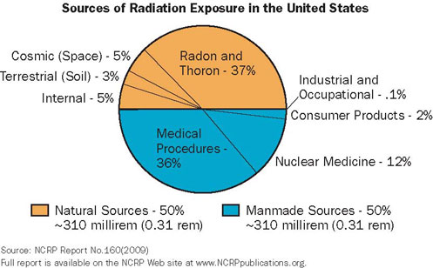
IONIZING RADIATION
Electromagnetic radiation:
X-rays (photons, no mass, no charge)
Gamma rays (photons, no mass, no charge)
Particulated radiation:
alpha radiation (two protons and two neutrons; positive charge)
beta radiation (essentially electrons; negative charge)
neutrons (no electrically charged)
U.S NRC
Notes:
Ionizing radiation is radiation with enough energy so that during an interaction with an atom, it can remove tightly bound electrons from the orbit of an atom, causing the atom to become charged or ionized.
There are two basic types of ionizing radiation: electromagnetic and particulated. Electromagnetic ionizing radiation such as X-rays and gamma rays has discrete packets of energy called "photons" that have neither mass nor electric charge. While X-rays come from the electronic part of the atom, gamma radiation originates in the nucleus. Electromagnetic ionizing radiation is used in pediatric healthcare for both imaging and cancer treatment.
Particulate radiation involves tiny fast-moving particles that have both energy and mass. Particulate radiation is primarily produced by disintegration of an unstable atom and the energy is carried by sub-atomic particles such as electrons, protons and neutrons. Beta and alpha radiation are examples of particulate radiation.
<<READ SLIDE>>
Ionizing radiation is a known carcinogen to which children are particularly vulnerable. Relevant exposures include pre- and postnatal irradiation for medical reasons, radon in the home, and accidental radiation releases. In some cases, children may receive higher doses than adults because of higher intake and accumulation. Furthermore, sensitivity to radiation is highest early in life. Although the mechanism of greater susceptibility is not well understood, it is likely to be linked to greater cell division in growing and developing tissues. In addition, a longer expected lifetime, with a resultant increased chance of repeated exposure and accumulated damage, also leads to higher cancer risk for children. Fetuses might be particularly sensitive to ionizing radiation, since their tissue cells are not only undergoing high rates of division, but are also differentiating into mature functional cells.
Reference:
Ionizing radiation, Part 1: X- and gamma-radiation, and neutrons. Lyon, International Agency for Research on Cancer, 2000 (IARC Monographs on the Evaluation of the Carcinogenic Risk to Humans, Volume 75).
Image:
U.S NRC (U.S. Nuclear Regularoty Commission) www.nrc.gov/reading-rm/basic-ref/glossary/exposure.html – Reprinted with permission of the National Council on Radiation Protection and Measurements, NCRPonline.org

Slide 50
PROTECTION FROM IONIZING RADIATION
Time
Decrease exposure time
Distance
Increase distance from source
Shielding
Introduce shielding
Develop norms and standards
Inspection and enforcement
EPA
Notes:
Effects of radiation can be decreased by decreasing exposure time, increasing distance from source or introducing shielding. Standards have been developed for industrial and medical applications.
References:
IAEA Safety Standards Series. Radiological protection for medical exposure to ionizing radiation. Co-sponsored by IAEA, PAHO and WHO. Safety Guide No. RS-G-1.5. Available at www-pub.iaea.org/MTCD/publications/PDF/Pub1117_scr.pdf - accessed December 2009
Safety Series. International Basic Safety Standards (BSS) for Protection against Ionizing Radiation and for the Safety of Radiation Sources. Co-sponsored by IAEA, WHO, PAHO, ILO, FAO and NEA/OECD (1996). Safety Series N° 15. Available at www-pub.iaea.org/MTCD/publications/PDF/SS-115-Web/Start.pdf - accessed December 2009
Image:
EPA. Radiation protection. Available at www.epa.gov/radiation – accessed December 2009.

Slide 51
Geology and Radon Gas
The concentration of radon gas that reaches the surface of the Earth and thus can enter our dwellings is
Related to the concentration of radon in the rocks (generally granitic rock) and soil.
Some regions in the United States contain bedrock with an above-average natural concentration of uranium.

Slide 52
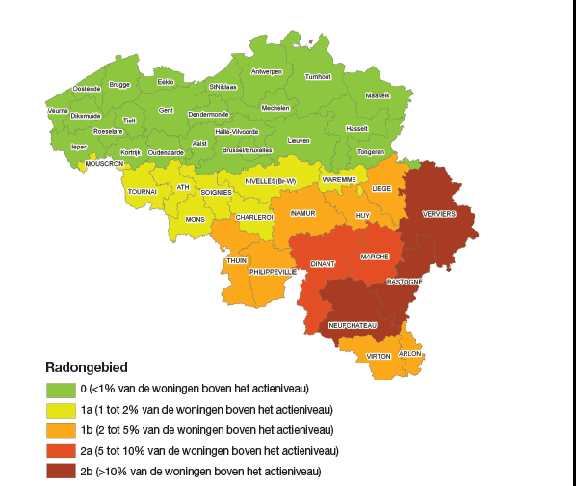
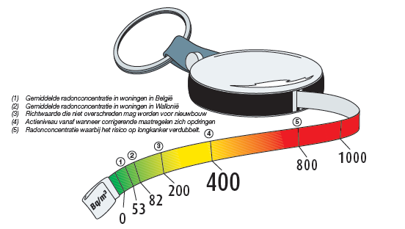

Slide 53
How Does Radon Gas Enter Building?
Radon gas enters homes and other buildings in three main ways:
1. It migrates up from soil and rock into basements and lower floors.
2. Dissolved in groundwater, it is pumped into wells and then into homes.
3. Radon-contaminated materials, such as building blocks that are used in construction.

Slide 54
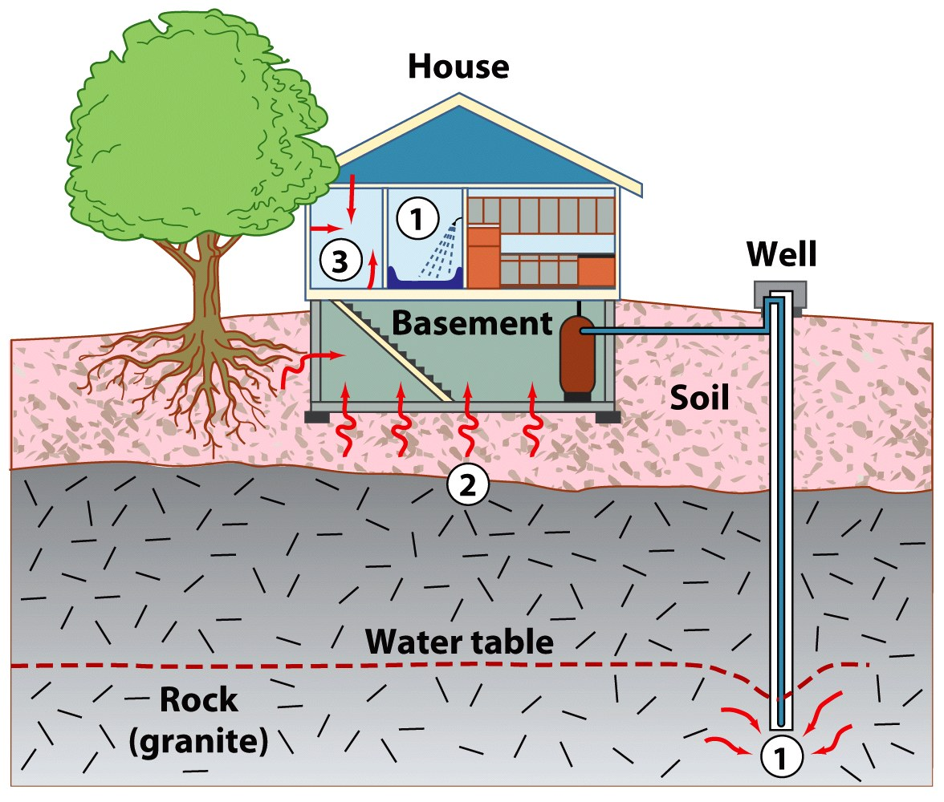

Slide 55
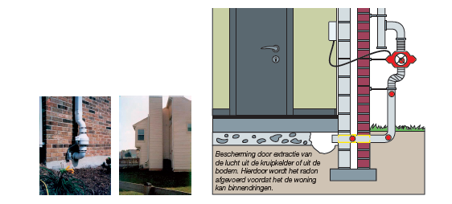
A. Gas Permeable Layer:
Allow the soil gas to move freely underneath the house.
B. Plastic Sheeting:
Help prevent the soil gas from entering the home.
C. Sealing and Caulking:
Openings in the concrete foundation floor are sealed to reduce soil gas entry into the home.

Slide 57
BIOLOGICAL POLLUTANTS
Biological pollutants are/were living organisms:
Animal dander, dust mites, moulds, infectious agents, pollen
Sources of biological agents:
Water-damaged surfaces and materials
Humidifiers and stagnant water
Water vapour from cooking and showering
Air conditioning systems
Mattresses, upholstered furniture and carpets
Dirt
Notes:
Dust mites, fungi and bacteria require moisture to proliferate. Permeation of rain or groundwater into a building and condensation on cold interior surfaces can promote proliferation of microbes. Water vapour is produced by people and pets, cooking and showering and requires sufficient air exchange to prevent moisture problems. Mattresses, upholstered furniture and carpets are reservoirs for dust mites.
Moulds have been associated with three types of effects: infections, allergic reactions and toxic effects. Toxic effects may be caused by inhalation of mycotoxins.
These notes are taken from the US EPA website www.epa.gov/iaq/pubs/bio_1.html

Slide 58
DUST MITES
Feed on human dander
Prefer warm, humid environments
Sources:
bedding, carpets, upholstery, soft toys
Prevention:
Encasing mattress and pillows
Washing bedding in hot water
Frequent vacuuming / damp mopping
Decreasing clutter
Removing carpets
CDC
Notes:
Dust mites are acarians (Dermatophagoides spp.)
The effectiveness of prevention measures against dust mite sensitization has been studied in a European multicentre randomized controlled trial. Intervention was a combination of education and mattress encasement. Of 566 preschool-aged children in the study’s first-year follow-up (mean age = 3.1 years), the incidence of sensitization to mite allergens was 10 (3%) of 330 in the intervention versus 20 (6.5%) of 306 in the comparison (control) group.
Likewise, in 213 school age children, 3 (2.56%) of 117 children in the intervention group and 9 (9.38%) of 96 in the comparison (control) group developed sensitization to dust mite.
Refs:
Tsitoura S et al. Randomized trial to prevent sensitization to mite allergens in toddlers and preschoolers by allergen reduction and education: one-year results. Arch Pediatr Adolesc Med, 2002, 156:1021-7.
Arshad SH et al. Prevention of sensitization to house dust mite by allergen avoidance in school age children: a randomized controlled study. Clin Exp Allergy, 2002, 32:843.
Arshad SH et al. Prevention of allergic disease during childhood by allergen avoidance: the Isle of Wight prevention study. J Allergy Clin Immunol. 2007 Feb;119(2):307-13.
BACKGROUND: Early life allergen exposure may increase the risk of childhood allergy, but the protective effect of reduction in allergen exposure remains uncertain. OBJECTIVE: To evaluate the effect of reduction in food and house dust mite (HDM) allergen exposure in infancy in preventing asthma and allergy. METHODS: Infants, at higher risk because of family predisposition, were recruited prenatally and randomized to prophylactic (n = 58) and control (n = 62) groups. Prophylactic group infants were either breast-fed with mother on a low allergen diet or given an extensively hydrolyzed formula. Exposure to HDM was reduced by the use of an acaricide and mattress covers. The control group followed standard advice. Development of allergic diseases and sensitization to common allergens (atopy) was assessed blindly at ages 1, 2, 4, and 8 years in all 120 children. RESULTS: Repeated measurement analysis, adjusted for all relevant confounding variables, confirmed a preventive effect on asthma: adjusted odds ratio (OR), 0.24; 95% CI, 0.09-0.66; P = .005; atopic dermatitis, OR, 0.23; CI, 0.08-0.64; P = .005; rhinitis, OR, 0.42; CI, 0.19-0.92; P = .03; and atopy, OR, 0.13; CI, 0.05-0.32; P < .001. The protective effect was primarily observed in the subgroup of children with persistent disease (symptoms at all visits) and in those with evidence of allergic sensitization. CONCLUSION: Allergic diseases can be reduced, for at least the first 8 years of life, by combined food and HDM allergen avoidance in infancy. CLINICAL IMPLICATIONS: Strict food and HDM allergen avoidance should be considered for prevention of allergy in high-risk infants.

Slide 59
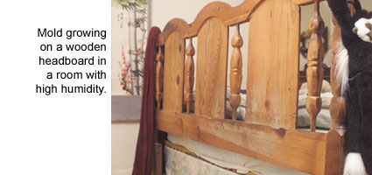
MOULDS
A frequently undetected environmental problem
Occur in damp indoor areas
Allergies and nonspecific symptoms are common, but infections are rare
EPA
Notes:
<<READ SLIDE>>
Ref:
Etzel RA et al. Indoor mold and children's health. Environ Health Perspect, 1999, 107(Suppl)3:463.
Reactive airways disease in children is increasing in many countries around the world. The clinical diagnosis of asthma or reactive airways disease includes a variable airflow and an increased sensitivity in the airways. This condition can develop after an augmented reaction to a specific agent (allergen) and may cause a life-threatening situation within a very short period of exposure. It can also develop after a long-term exposure to irritating agents that cause an inflammation in the airways in the absence of an allergen. (paragraph) Several environmental agents have been shown to be associated with the increased incidence of childhood asthma. They include allergens, cat dander, outdoor as well as indoor air pollution, cooking fumes, and infections. There is, however, increasing evidence that mould growth indoors in damp buildings is an important risk factor. About 30 investigations from various countries around the world have demonstrated a close relationship between living in damp homes or homes with mould growth, and the extent of adverse respiratory symptoms in children. Some studies show a relation between dampness/mould and objective measures of lung function. Apart from airways symptoms, some studies demonstrate the presence of general symptoms that include fatigue and headache and symptoms from the central nervous system. At excessive exposures, an increased risk for haemorrhagic pneumonia and death among infants has been reported. The described effects may have important consequences for children in the early years of life. A child's immune system is developing from birth to adolescence and requires a natural, physiological stimulation with antigens as well as inflammatory agents. Any disturbances of this normal maturing process will increase the risk for abnormal reactions to inhaled antigens and inflammagenic agents in the environment. The knowledge about health risks due to mould exposure is not widespread and health authorities in some countries may not be aware of the serious reactions mould exposure can provoke in some children. Individual physicians may have difficulty handling the patients because of the lack of recognition of the relationship between the often complex symptoms and the indoor environment.

Slide 60
CHEMICAL AGENTS PRODUCED BY MOULDS
Mycotoxins are associated with human disease and cause acute and chronic effects
Mycotoxins
Aflatoxins
Tricothecenes
Ochratoxins and citrinin
Hundreds of others
Glucans (cell wall components)
Volatile organic compounds (irritating)
Notes:
Mycotoxins are associated with human disease.
Tricothecenes inhibit protein synthesis and have many acute effects, including anemia and infant pulmonary haemorrhage.
Ochratoxins and citrinin cause nephropathy and immunosuppression.
Aflatoxins are hepatotoxins and are carcinogenic.
(See module on Mycotoxins)
Refs:
Etzel RA. What the primary care pediatrician should know about syndromes associated with exposures to mycotoxins. Curr Probl Pediatr Adolesc Health Care. 2006;36(8):282-305.
Disease associated with exposure to mycotoxins is known as the "Great Masquerader" of the 21st century because of its complex natural history involving different tissues and resembling different diseases at each stage in its evolution. It can present with a variety of nonspecific clinical signs and symptoms such as rash, conjunctivitis, epistaxis, apnea, cough, wheezing, nausea, and vomiting. Some cases of vomiting illness, bone marrow failure, acute pulmonary hemorrhage, and recurrent apnea and/or "pneumonia" are associated with exposure to mycotoxins. Familiarity with the symptoms of exposure to the major classes of mycotoxins enables the clinician to ask pertinent questions about possible fungal exposures and to remove the infant or child from the source of exposure, which could be contaminated food(s), clothing and furniture, or the indoor air of the home. Failure to prevent recurrent exposure often results in recurrent illness. A variety of other conditions, including hepatocellular and esophageal cancer and neural tube defects, are associated with consumption of foods contaminated with mycotoxins. Awareness of the short- and long-term consequences of exposures to these natural toxins helps pediatricians to serve as better advocates for children and families.
Novak M et al. Beta-glucans, history, and the present: immunomodulatory aspects and mechanisms of action. J Immunotoxicol. 2008 Jan;5(1):47-57.
The present paper represents a comprehensive up-to-date review of beta -glucans, their chemical and biological properties, and their role in immunological reactions. beta -D-Glucans belong to a group of physiologically active compounds called biological response modifiers and represent highly conserved structural components of cell walls in yeast, fungi, or seaweed. Despite almost 150 years of research, the exact mechanisms of their action remain unclear. The present review starts with the history of glucans. Next, attention is focused on sources and structure, comparing the effects of physicochemical properties, and sources on biological effects. As glucans belong to natural products useful in preventing various diseases, they have been highly sought after throughout human history. Based on extensive recent research, this paper explains the various mechanisms of effects and the ways glucans mediate their effects on defense reactions against infections. Despite the fact that predominately pharmacological effects of glucans are positive, their unfavorable and potentially toxic side effects were not overlooked. In addition, attention was focused on the future research, possible alternatives such as synthetic oligosaccharides, and on clinical applications.

Slide 62
Asbestos
Asbestos is a set of six naturally occurring silicate minerals used commercially for their desirable physical properties.
Long (ca. 1:20 aspect ratio), thin fibrous crystals.
The prolonged inhalation of asbestos fibers can cause serious illnesses including malignant lung cancer, mesothelioma, and asbestosis .The trade and use of asbestos have been restricted or banned in many jurisdictions.

Slide 63
Serpentine class
Amphibole class
Chrysotile (white)
Amosite
(brown)
Crocidolite (blue)
Chrysotile
tremolite, anthophyllite and actinolite

Slide 64
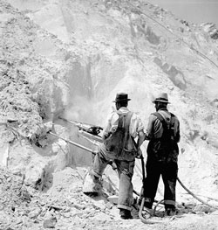
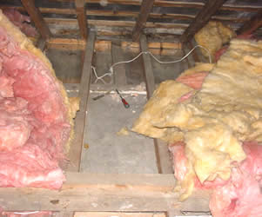
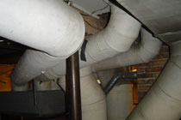
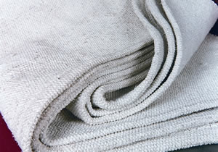
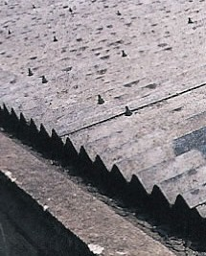
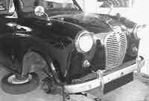
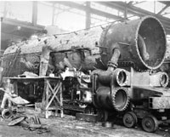
Mine
Ship insulation
Attic insulation
Lamp wicks
Fire blanket
Pipe insulation
Roofing products
Locomotive
insulation
Brake pads

Slide 65
APPROACHES TO REDUCE INDOOR AIR POLLUTION
Eliminate or control the sources of pollution
Improved stoves
Clean fuels (kerosene, gas)
Venting stoves for cooking and heating
Regular maintenance of cooking, heating and cooling systems
Choose non-volatile, non-toxic building materials
Maintaining dry homes and schools
Ventilation – building design
Dilute and remove pollutants through ventilation with outdoor air
Air cleaning – NOT air fresheners!
Air filters and ionizers may remove some airborne particles
Gas adsorbing material is used to remove gaseous contaminants
Notes:
It is always better to prevent rather than treat illness. To avoid problems due to indoor air quality, the first approach is source reduction and elimination, and the second, proper ventilation and maintenance of gas, oil and solid fuel cooking, heating and cooling systems. Air cleaning is the least effective, and most expensive. Air fresheners, which contain untested potentially harmful volatile organic compounds (VOCs), should not be used to cover up stale air or unpleasant smells.
Ref:
www.epa.gov/iaq/pubs/ozonegen.html
For more information on indoor air pollution, you can obtain a guide (Indoor pollution: An introduction for health professionals) recently published by the US EPA at: www.epa.gov/iedweb00/pubs/hpguide.html
Ref:
Meklin T et al. Effects of moisture-damage repairs on microbial exposure and symptoms in schoolchildren. Indoor Air. 2005;15 Suppl 10:40-7.
Effects of renovation on symptom prevalence and microbial status were studied in two moisture-damaged schools and in two non-damaged schools with longitudinal cross-sectional surveys before and after repairs. Over 1300 schoolchildren aged 6-17 returned questionnaires before and after repairs. After full renovation in one of the damaged schools, elevated concentrations and increased frequencies of indoor air fungi normalized and a significant decrease in the prevalence of 10 symptoms of 12 studied was observed among schoolchildren. No change in microbial conditions was seen after partial repairs in the other damaged school, and only slight improvement was observed in symptom prevalence. The change in the prevalence of symptoms in the reference schools was minor. The results suggest that increased symptom prevalence among schoolchildren in moisture-damaged schools can be managed with proper repair of the moisture damage. PRACTICAL IMPLICATIONS: This longitudinal intervention study showed the positive effects of the moisture and mold damage repairs of a school building on children's health. The success necessitates however, a thorough renovation including appropriate ventilation. Monitoring of airborne viable microbes revealed the damage status of the building and thus could be used as a tool in evaluating the quality of repairs.

Slide 66
We can reduce indoor air pollution
In developed countries:
Use low-toxicity material
Monitor air quality
Keep rooms clean
Limit exposure to chemicals
Allow for better mixing of indoor & outdoor air
In developing countries:
Dry wood before burning
Cook outside
Use less-polluting fuels (natural gas)

Slide 67
Thanks for your attention!
The EnVOC research group
www.EnVOC.UGent.be
Christophe.Walgraeve@UGent.be
Herman.VanLangenhove@UGent.be

Slide 68
Analysis of VOC in air

Slide 69
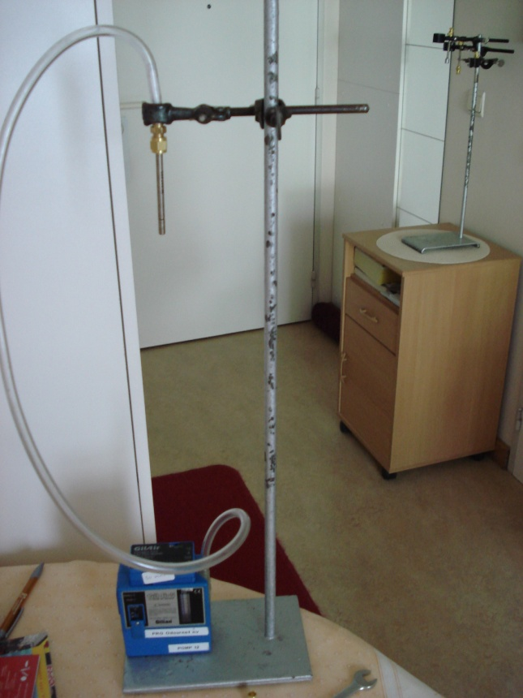
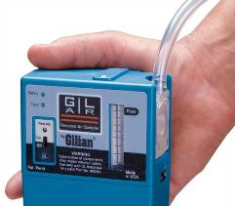
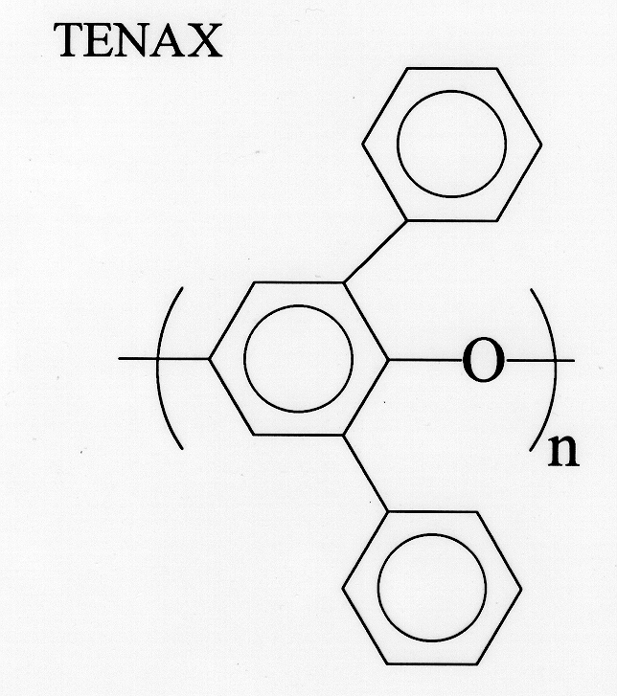
69 /49
Sampling
Sample preparation
69 /49
A. Active sampling of VOCs in air
Notes:
Via actieve monstername wordt een gekende hoeveelheid lucht met behulp van een pomp doorheen een monsternamebuisje gepompt. De VOCs in de lucht worden weerhouden op het sorbentmateriaal

Slide 70
Separation and detection
Thermal desorption – Gas Chromatography – mass spectrometry
Notes:
Daarna volgt de analyse. Het monsternamebuisje wordt verhit. De VOCs komen vrij en worden gescheiden in de gaschromatograaf waarna detectie gebeurt met behulp van massaspectrometrie.

Slide 72
Result of TD-GC-MS analysis: Chromatogram

Slide 73
Result of TD-GC-MS analysis: Chromatogram
Identification: mass spectrum

Slide 74
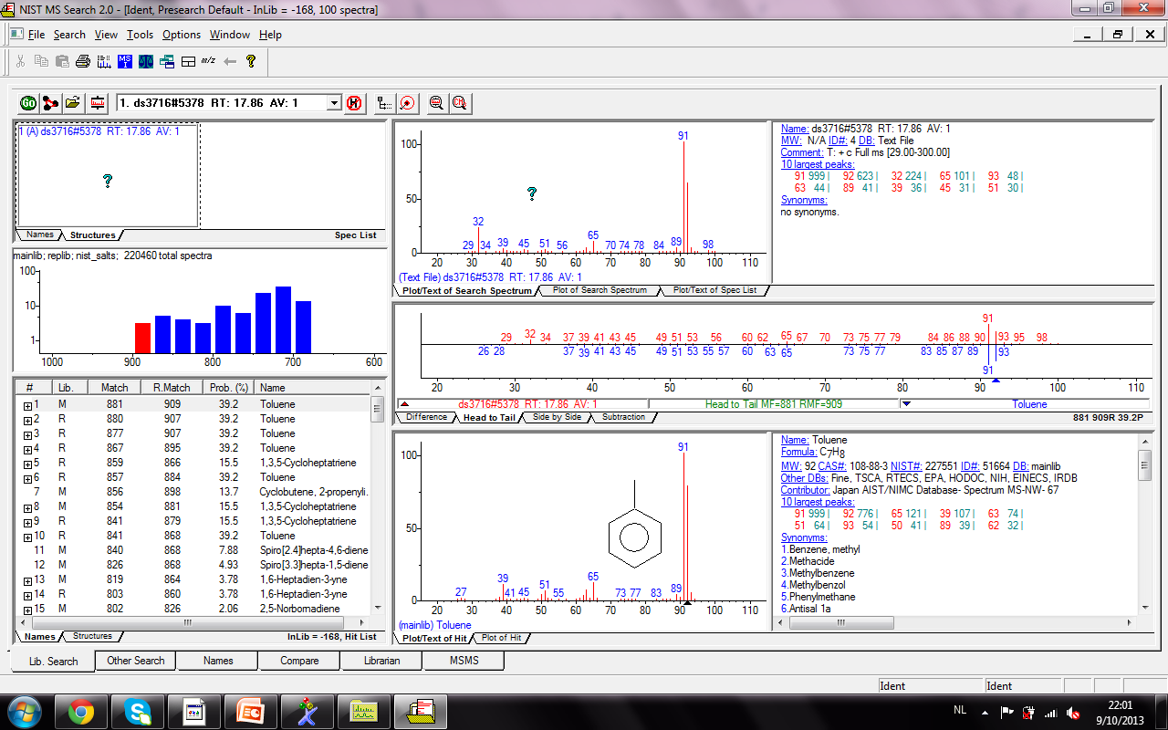
Confirmation: NIST library AND theoretical fragmantation patterns

Slide 75
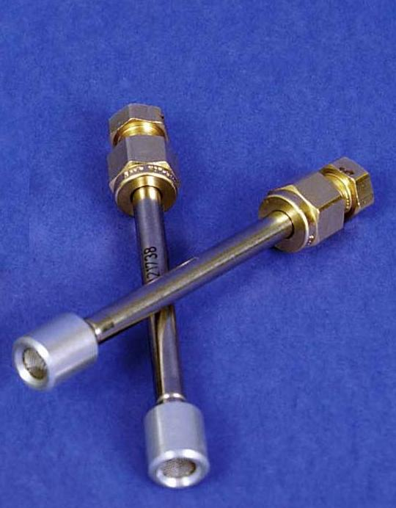
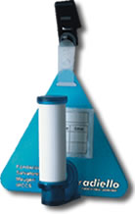
Sampling
Sample preparation
B. Passive sampling of VOCs in air
Ease of use
No pump needed, no electricity
Based on diffusion
TWA-concentrations
Different types available
Notes:
Naast actieve monstername, kan passieve monstername worden aangewend. Passieve monstername maakt geen gebruik van een pomp en is daardoor onafhankelijk van energievoorzienng. Een passief bemonsteringsapparraat wordt blootgesteld gedurende een periode van een dag tot enkele weken, waarna het op een analoge manier kan worden geanalyseerd in het labo met behulp van GC-MS. Tijdens dit onderzoek hebben we dit passief monsternameapparaat geevalueerd

Slide 76
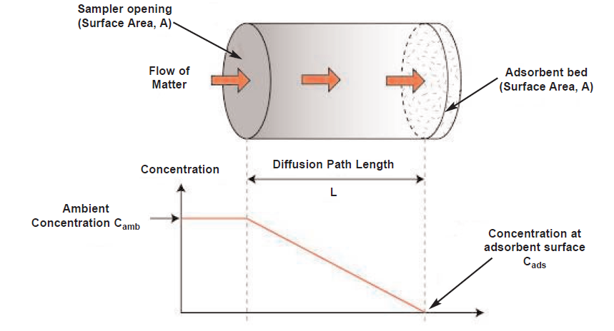
Sampling
Sample preparation
Notes:
Passief monsternametoestel bestaat uit een sorbent materiaal, dat afgescheiden is van de lucht die we wensen te analysere via een barriere (stilstaande lucht) Transport in deze barriere verloopt enkel door moleculaire diffusie. De massa van een bepaalde analyt die wordt getransporteerd naar het sorbent materiaaal gedurende een blootstellingstijd t is afhangkelijk van diffusiecoeff D geometrie A/L en de drijvende kract C-C0. Wanneer de veronderstelling gemaakt wordt dat C0=0, dan kan deze vergelijking herschreven worden. De factor DA/L noemt men ideale uptake rate

Slide 77
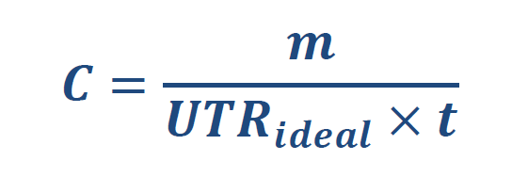
Sampling
Sample preparation

Slide 79
Major Indoor Pollutants
Pollutant Source Health Effects
1, 1, 1-Trichloroethane | Aerosol sprays | Dizziness, breathing irregularities
Asbestos | Pipe insulation, ceilings, floor tiles, oven mitts | Lung Cancer and asbestosis
Benzo−α−pyrene | Tobacco smoke, woodstoves | Lung Cancer
Carbon Monoxide | Faulty furnaces, cigarette smoke | Headache, heartbeat irregularities, death, CO has 250x affinity for hemoglobin than O₂

Slide 80
Chloroform | Pulp and paper mills, water and wastewater plants | Cancer
Formaldehyde | Paneling, particle board, furniture, carpeting, adhesives | Nausea, dizziness, irritation of throat, eyes, and lungs
Methylene chloride | Paint strippers and thinner – persistent | Nerve disorders, diabetes
Nitrogen oxides | Furnaces, stoves, fireplaces and vents | Headaches, irritated lungs
Para-dichlorobenzene | Air fresheners, mothballs | Cancer

Slide 81
Radon – 222 | Soil and rock near house foundation, concrete | Lung cancer
Styrene | Carpets, plastics, | Kidney & liver damage
Tetrachlor- ethylene | Dry-cleaning fluid | Nerve disorders, damage to liver and kidneys, cancer
Tobacco Smoke | Cigarettes and other smoking sources | Lung cancer and heart disease
Organic Material (Living Organisms) | Dust mites, fungal and algal spores, dust (human skin), animal dander, hair, carpet fibers, fur | Allergies, coughs, sneezing, eye irritation, sore throats, difficulty breathing

