Slide 1
ADVANCED WASTE GAS TREATMENT TASK PRESENTATION TREATMENT OF FLUE GAS FROM MEDICAL WASTE INCINERATORS IN RWANDA
HABIMANA VALENS
Master Student, Ghent University

Slide 2
Outline
Introduction to medical wastes and sources
Treatment of medical wastes in Rwanda.
Pollution from medical waste incinerators
Acid flue gas removal
Removal of heavy metals
Conclusion

Slide 3
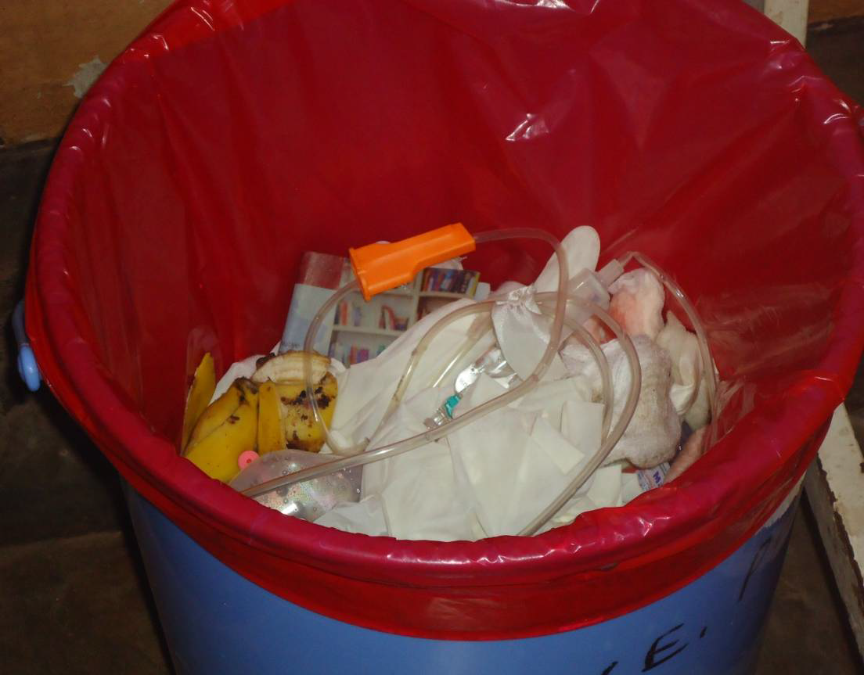
INTRODUCTION
Biomedical waste consists of solids, liquids, sharps, and laboratory waste that are potentially infectious or dangerous.

Slide 4
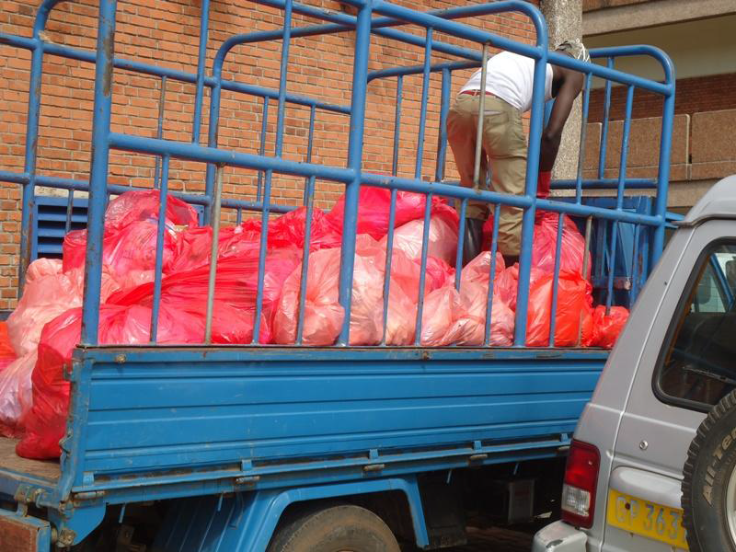
Medical waste produced in Rwanda amounts to approximately 4,171 tons a year and is projected to grow at a rate of 5% year on year

Slide 5
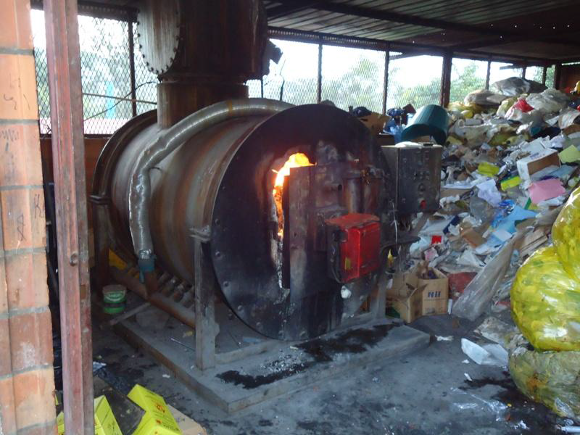
Treatment of medical waste in Rwanda
Incineration is the method commonly used for the treatment of medical wastes.

Slide 6
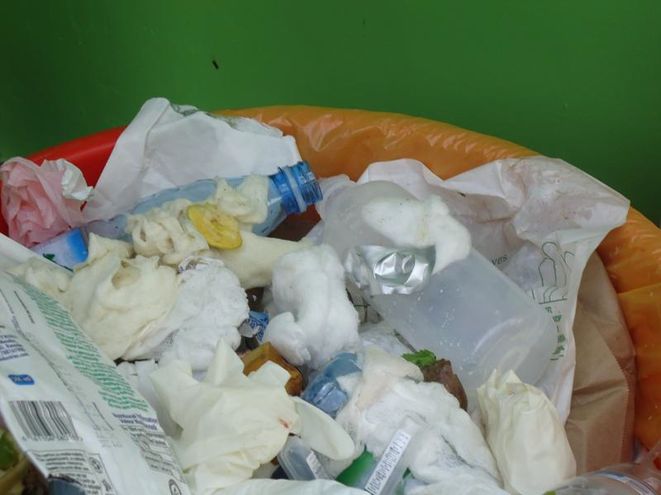
not recommended for pharmaceutical wastes, chemical wastes, genotoxic wastes and radioactive wastes, pressurized containers, halogenated plastics (PVCs), and wastes containing heavy metals

Slide 7
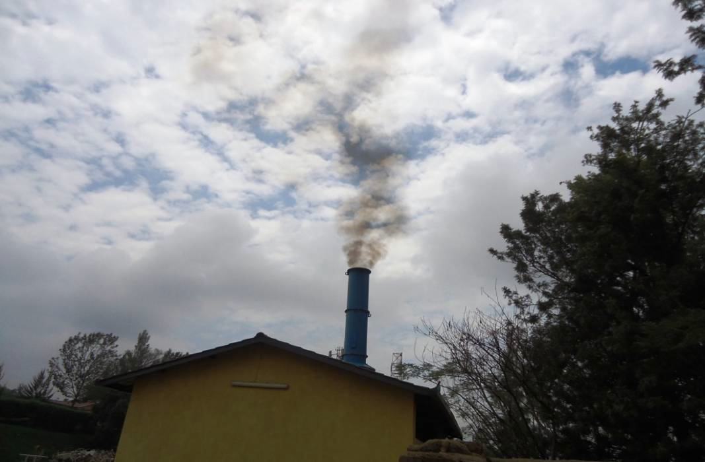
The government purchased incinerators to effectively and safely dispose toxic substances
about Rwf 1.5 billion on supply and installation of incinerators in 8 hospitals

Slide 8
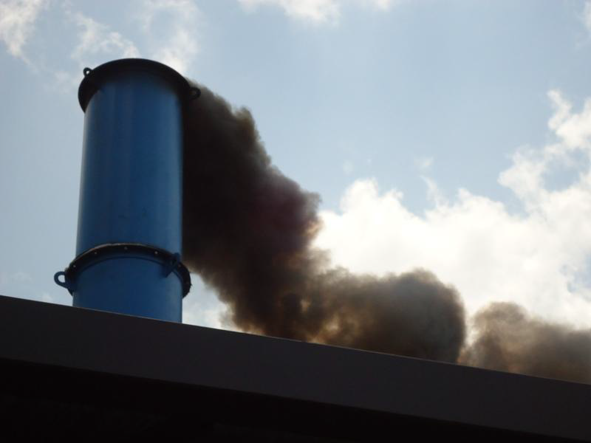
Incinerators emit heavy black smoke that is polluting the surrounding atmosphere
black smoke is a sign that the incinerator is either inadequate or not properly operated.

Slide 9
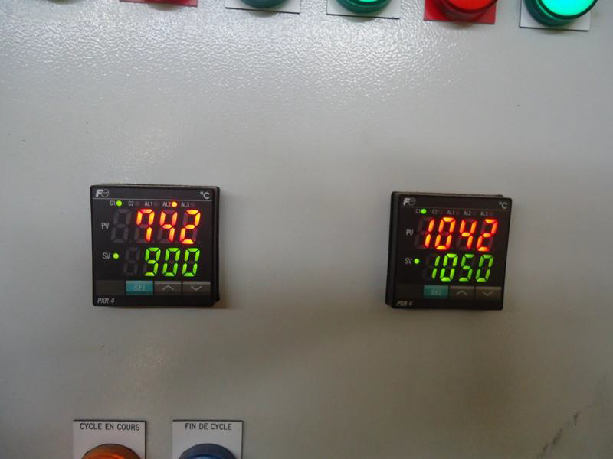
incinerators should achieve desired temperatures, residence times, it has to destroy pathogens, minimize emissions and minimize fuel consumption.

Slide 10
the combustion temperatures that is not the required standards
most of the incinerators are not equipped with filters that retain or significantly reduce the amount of smoke emitted
A lot of medical waste being incinerated still contains a significant amount of plastics.

Slide 11
Emission from medical waste incinerators
Emission of heavy metals (e.g. Pb, Cu, Cd, Cr, Ni and Hg), HCl, SOx, NOx, CO,CO2 and N2O, VOCs, PCDD/Fs, PAHs.
incineration of waste containing Cl, F or S produce acid flue gas with volatile Cl, F and SO2. cause acid rain and damage ecosystems and buildings
Heavy metals can accumulate in food chain and cause health problems

Slide 12
Pollution control
Good separation of waste and avoid incinerating plastics
modification of process techniques and physical parameters to optimize combustion conditions
abatement techniques: removal of acid flue gas and HM
regulations

Slide 13
Acid flue gas removal
Wet scrubber is used to remove the acids. The scrubber create an acid waste water that is neutralized by a base
Acid + base → salt + water
We have an acid stage and basic stage. Cl and F come in wash water in acid stage and SO2 is washed out in basic (or neutral) stage

Slide 14
Scrubber

Slide 15
SO2 will not come in washing water, we need a second stage to remove this
We use semi-dry scrubbers/spray absorber: consist of adding a base to form a salt + dust removal. the PH is on neutral condition.
you use the calcium hydroxide and water, water evaporate and on the surface of the droplet the acid react with the base and you produce salt.
You make the particles and you have to remove the particles.

Slide 16
Removal of metals
HM are removed by a wet system scrubber, the temperature is low they will condensate and be in water and are removed out by addition of a metal binding complex.
This gives sludge that contains HM and it is a hazardous waste
activated carbon adsorbs also gaseous HM and waste generated is a hazardous waste

Slide 17
conclusion
Improve the way the wastes are separated and the way the incinerators are maintained.
There is a need to set strict rules for operation technical instructions and emission limits.
Complete combustion is very important, keep the incineration at a temperature of at least 850°C and excess air is needed(O2 should be >6%).
Emissions to air must be measured continuously or periodically

