Slide 1
Biotechnological processes: calculation exercises

Slide 2
General
Lecturers: Peter Clauwaert en Jan Arends
Questions: peter.clauwaert@ugent.be
Computer exercises: Dries Seuntjens (dries.seuntjens@ugent.be)
➔ Put [Biotech] in the subject
Course notes : VLK cursusdienst. New version!

Slide 3
General
Goal: getting insight in biotechnological processes in wastewater treatment by making calculations
Actively making exercises during courses, no passive listening
bring your calculator
Open book exercise during exam
Course notes can be taken with you

Slide 4
When and where do we meet
ZIE LIJSTEN OP MINERVA VOOR GROEPSINDELING

Slide 5
Stoichiometry

Slide 6
Choose your option
Bachelor Bio-Ir milieu
Bachelor Bio-Ir Ch & V
Bio-Ir (keuzevak)
Andere
10

Slide 7
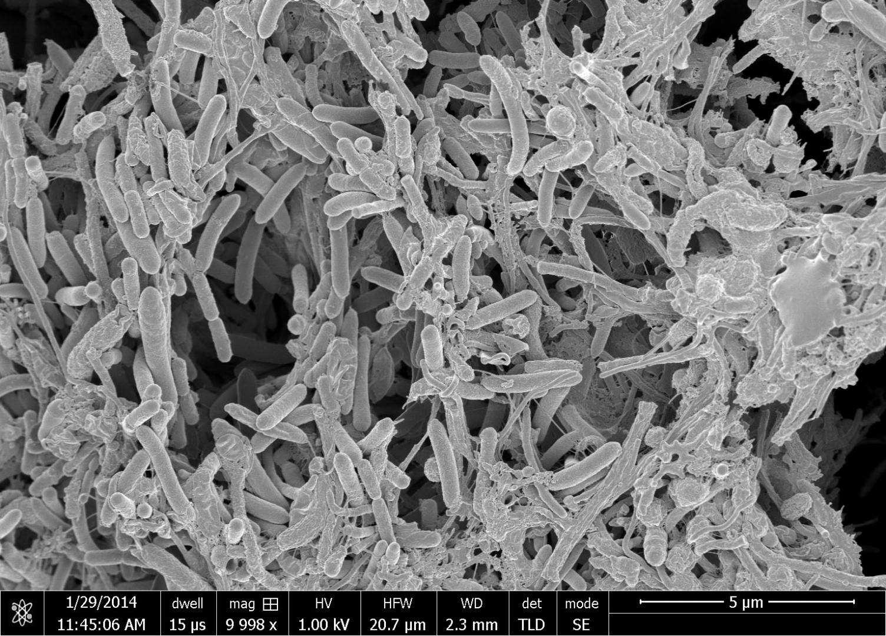
In July 2013, Colruyt Group became the first company in Belgium to own a Hyundai ix35 that runs on hydrogen
Microorganisms

Slide 8
Halfreactions: how much electrons involved?
Gram organic compounds → gram COD
‘Energy state’ of the electrons in a halfreaction (~redoxpotential)
Which combinations of halfreactions can thermodynamically occur?
How much energy can be released by specific reactions?

Slide 9
Growth reference system (GRS)
Gibbs energy is zero for stable end products in microbial systems
HCO₃⁻, SO₄²⁻, NO₃⁻, H₂O, H⁺
At biochemical standard conditions
1 atm, 298.15K, pH 7, 1 mol/L
Never mix these values with conventional thermodynamical data!
See also table 1
C +4
H +1
O -2
S +6
P +5
N +5
- +1
+ -1

Slide 10
Reaction stoichiometry
Half reactions
Electron balance
Carbon/nitrogen/sulfur/phosphorus balance
Oxygen balance: H₂O
Hydrogen balance: protons
Charge balance as final check
➔ e.g. Acetate to bicarbonate conversion (oxidation half reaction, notes p 6)

Slide 11
Exercise 1: nitrification
Nitrification: conversion of NH₄⁺ to NO₃⁻
Oxidation reaction
Electrons: NH₄⁺ → 8e⁻
Nitrogen: NH₄⁺ → NO₃⁻ + 8 e⁻
Oxygen: NH₄⁺ + 3 H₂O → NO₃⁻ + 8 e⁻
Hydrogen: NH₄⁺ + 3 H₂O → NO₃⁻ + 10 H⁺ + 8 e⁻

Slide 12
Exercise 1: nitrification
Reduction reaction: reduction of O₂ to H₂O
Electrons: O₂ + 4e⁻ → H₂O
Oxygen: O₂ + 4e⁻ → 2 H₂O
Hydrogen: O₂ + 4e⁻ + 4H⁺ → 2 H₂O
Complete reaction = sum of oxidation and reduction
Or…

Slide 13
Exercise 1: nitrification
Complete reaction:
Electrons: ammonia (8), oxygen (4)
NH₄⁺ + 2O₂
Nitrogen: NH₄⁺ + 2O₂ → NO₃⁻
Oxygen: NH₄⁺ + 2O₂ → NO₃⁻ + H₂O
Hydrogen: NH₄⁺ + 2O₂ → NO₃⁻ + H₂O + 2H⁺

Slide 14
Halfreactions: how much electrons involved?
Gram organic compounds → gram COD
‘Energy state’ of the electrons in a halfreaction (~redoxpotential)
Which combinations of halfreactions can thermodynamically occur?
How much energy can be released by specific reactions?

Slide 15
Calculation of the COD of an organic molecule
See also theory course notes p. 51
Steps:
Calculate the degree of reduction of the molecule (mol e-?)
4 mol e⁻ per mol O₂
32 g COD per mol O₂
Divide by the molecular weight:
Result = g COD/ g substrate
Acetate: 59,04 g/mol
Ethanol: 46,01 g/mol
Glucose: 180,16 g/mol

Slide 16
Calculate the COD of ethanol (g COD/g ethanol)
1,39 g COD/g ethanol
96 g COD/g ethanol
2,09 g COD/g ethanol
2,29 g COD/g ethanol
?
1

Slide 17
Solution
Ethanol
Electrons: 2 X (+4) + 6 X (+1) + 1 X (-2)
= 12 mol e⁻/mol ethanol
COD = 12 /4 X 32 = 96 g COD/mol ethanol
COD/weight =
= 2,09 g COD/ g ethanol
Acetate: 1,08 g COD/g
Glucose: 1,06 g COD/g

Slide 18
Do you understand the concept of COD calculations with the GRS?
Yes
No
1

Slide 19
Halfreactions: how much electrons involved?
Gram organic compounds → gram COD
‘Energy state’ of the electrons in a halfreaction (~redoxpotential)
Which combinations of halfreactions can thermodynamically occur?
How much energy can be released by specific reactions?

Slide 20
Gibbs energy per electron
ΔG’_{r} : Gibbs free energy for production of the molecule
Calculated with conventional values, after production with the reference substances (bicarbonate, nitrate, …)
ΔG’_{e} : Gibbs free energy per electron
Divide ΔG_{r} by the degree of reduction (γ)

Slide 21
Simplifying thermodynamical reactions
CalculateΔG’_{r}of a reaction by multiplyingthe ΔG’_{e}with the degrees of reduction and reactioncoëfficient
Reactionpotentials can be calculatedaccordingly
E = $\frac{−{∆G}_{r}^{°′}}{nF}$ = $\frac{−{∆G}_{e}^{°′}}{F}$

Slide 22
Halfreactions: how much electrons involved?
Gram organic compounds → gram COD
‘Energy state’ of the electrons in a halfreaction (~redoxpotential)
Which combinations of halfreactions can thermodynamically occur?
How much energy can be released by specific reactions?

Slide 23
Concentration effects
Conditions can differ from 1 atm, 298.15 K, 1 mol/L and pH 7
If not: correct:
Temperature
Concentration
Partial pressure
pH
➔ Part 1.4 + exercise 3 (@home) [-27 kJ/mol]

Slide 24
Halfreactions: how much electrons involved?
Gram organic compounds → gram COD
‘Energy state’ of the electrons in a halfreaction (~redoxpotential)
Which combinations of halfreactions can thermodynamically occur?
How much energy can be released by specific reactions?

Slide 25
Stoichiometry in WWTP
Organic matter removal
Domestic waste: C₁₀H₁₉O₃N, glucose as simplification
Aerobic: O₂ as electron acceptor

Slide 26
Stoichiometry in WWTP
Anoxic/Anaerobic: HCO₃⁻ as electron acceptor; thermodynamically less favourable
Other electron acceptors: see removal of nutrients

Slide 27
Stoichiometry in WWTP
Nitrogen removal
Nitrification: autotrophic bacteria

Slide 28
Stoichiometry in WWTP
Nitrogen removal
Denitrification: hetertrophic bacteria: need a carbon source!
 | ∆G^{0’}_{r} (kJ/mol)
5 * (Glucose + 12 H₂O  6 HCO₃⁻ + 30 H⁺ + 24 e⁻ 24 * (NO₃⁻ + 6 H⁺ + 5 e⁻  0.5 N₂ + 3 H₂O ---------------------------------------------------------------------- 5 Glucose + 24 NO₃⁻ → 12 N₂ + 6 H⁺ + 12 H₂O + 30 HCO₃⁻ | -954) -361) --------------------------- -13434
How much glucose is needed per gram of nitrate-N removed?

Slide 29
Do you understand the term NO₃⁻-N?
Yes
No
1

Slide 30
NO₃⁻-N
Nitrogen
“Origin” of nitrogen source is added
e.g. NH₄⁺-N, NO₃⁻-N
Only take molecular mass of N into account, no other elements
Also for other compounds: SO₄²⁻-S

Slide 31
How much glucose is needed per g N removed (through denitrification)
2,68 g
0,60 g
0,21 g
12,86 g
?
1

Slide 32
Exercise 4
5 mol glucose per 24 mol N
= 900 g glucose per 336 g N
= 2,68 g glucose per g N

Slide 33
Calculate the price of methanol per kg NO₃⁻-N removed
0,80 €/kg N
0,15 €/kg N
0,67 €/kg N
1,00 €/kg N
?
1

Slide 34
Methanol
32,04 g/mol

Slide 35
Exercise 4
5 (Methanol + 2 H₂O  HCO₃⁻ + 7 H⁺ + 6 e )
6 (NO₃⁻ + 6 H⁺ + 5 e⁻  0.5 N₂ + 3 H₂O )
5 Methanol + 6 NO₃⁻ + H⁺ → 3 N₂ + 5 HCO₃⁻ + 8 H₂O
5 mol methanol per 6 mol N
= 160 g methanol per 84 g N
= 1,90 g methanol per g N
€ 0,67 per kg N removed
Glucose: € 0,8 per kg N removed
Methanol = cheaper than glucose

Slide 36
Stoichiometry in WWTP
Sulfur removal: reduction to sulfide
In sewer systems: corrosion due to formation of H₂S → to be avoided!

Slide 37
Biomass production
Previous reactions = Catabolic
Need also to include anabolic reactions → bacteria use part of the electron donor for biomass synthesis

Slide 38
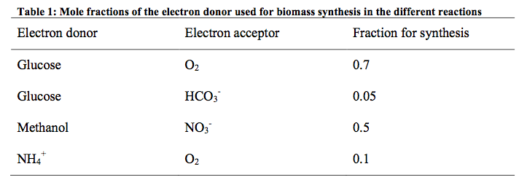
Biomass production
Less biomass production in the anaerobic system = big advantage!
Less sludge production = less sludge to be removed

