Slide 1
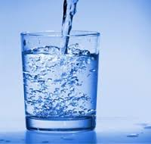
Urban and Indoor Air Pollution
EXPOSURE : daily intake
Air 27 kg/day
Food 1 kg/day
Water 1.5kg/day
1 Breath = 1 L / 15 times a minute / density 1.29 kg/m ³

Slide 2
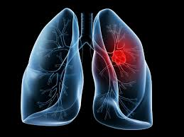
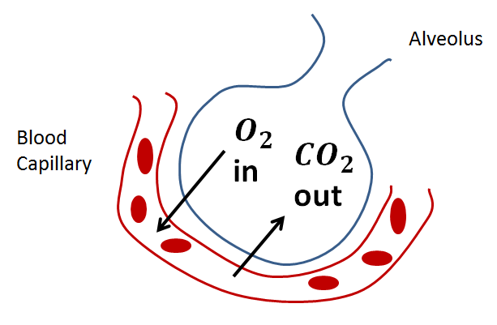
EXPOSURE : intensity
 | Large surface area | Short diffusion distance | Maintained concentration gradient
Human | Total alveoli = 70-100m² ^{[10]} | Alveolus + Capillary = 2-cells | Constant blood flow in capillaries; breathing

Slide 3
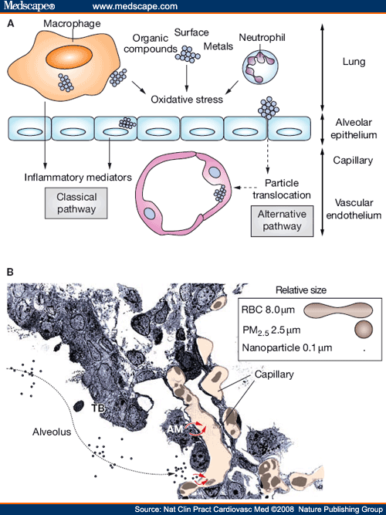
EXPOSURE : direct uptake
particulate matter
The hypothetical effector pathways through which airborne particulate matter influences cardiovascular risk. (A) Classical and alternative pathways through which combustion-derived nano-particulate matter induces cardiovascular effects. (B) Transmission electron micrograph of the alveolar-duct–terminal bronchiolar region that demonstrates the close proximity between the alveolar wall and capillary network. Particle translocation from the airways into the circulation may occur directly or after ingestion by alveolar macrophages. Abbreviations: AM = alveolar macrophages; PM = particulate matter; RBC = red blood cell; TB = the alveolar-duct–terminal bronchiolar region.

Slide 4
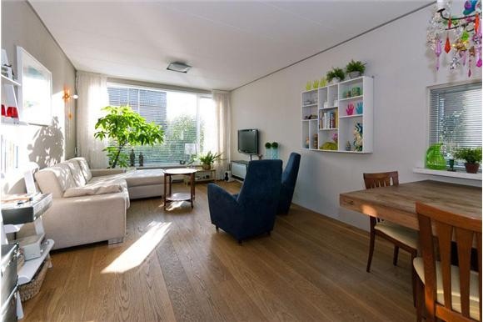
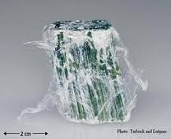
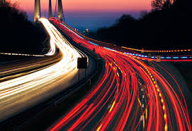
EXPOSURE : continuous
Ambient
Rural
Urban
Indoor
Working occupational health
At home

Slide 5
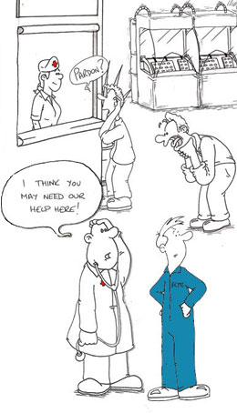
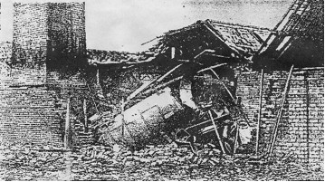
Physical and mechanical hazards
Biological and chemical hazards
Psychosocial hazards

Slide 6
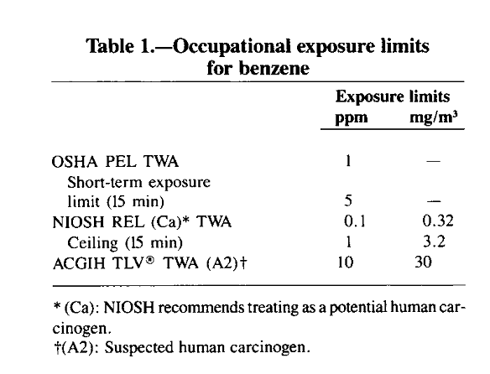
permissible exposure limit (PEL or OSHA PEL
A PEL is usually given as a time-weighted average (TWA), although some are short-term exposure limits (STEL) or ceiling limits.
A ceiling REL is designated by "C" preceding the value; unless noted otherwise, the ceiling value should not be exceeded at any time
American Conference of Industrial Hygienists (ACGIH)

Slide 7
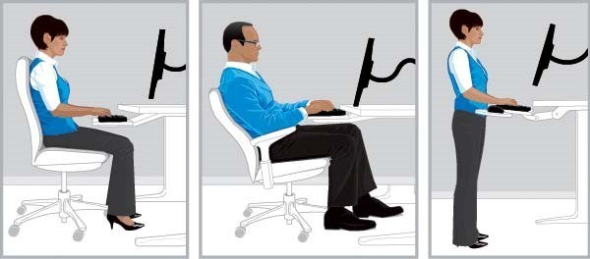
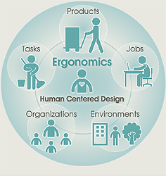
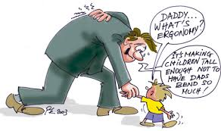
Ergonomics at work

Slide 8
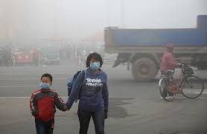
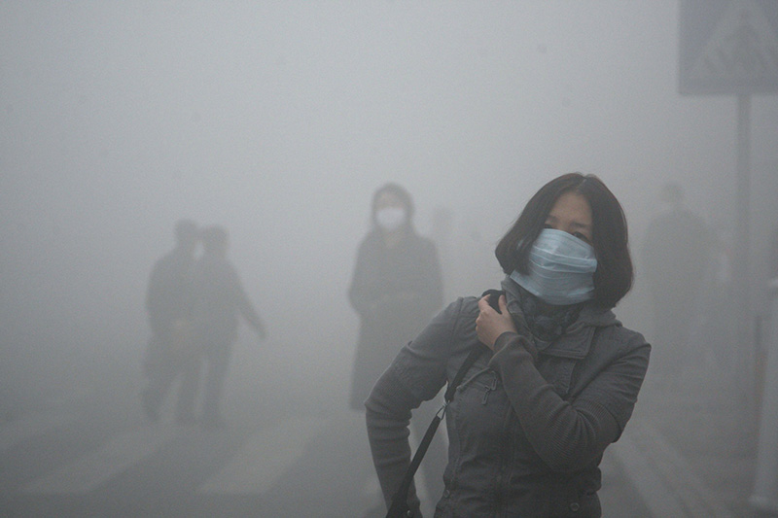
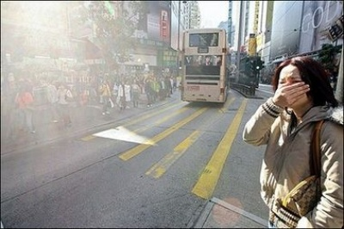

Slide 9
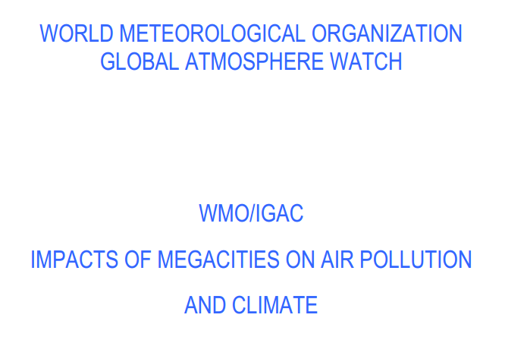
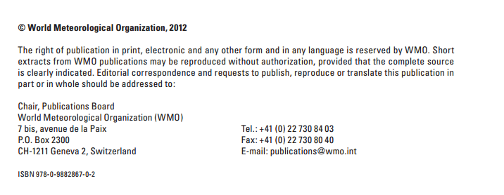

Slide 10
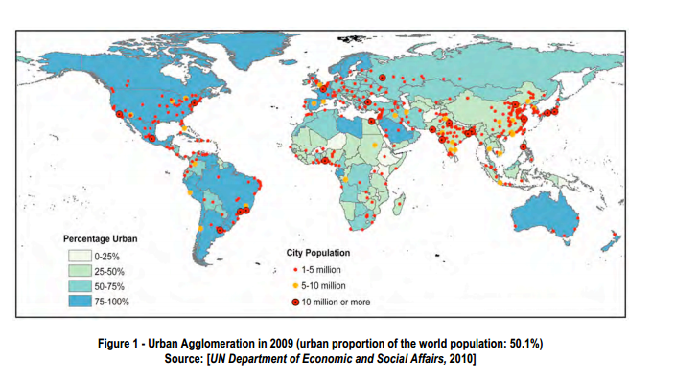

Slide 11
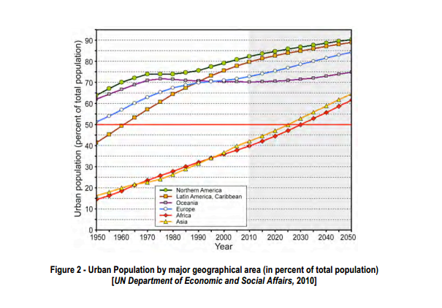

Slide 12
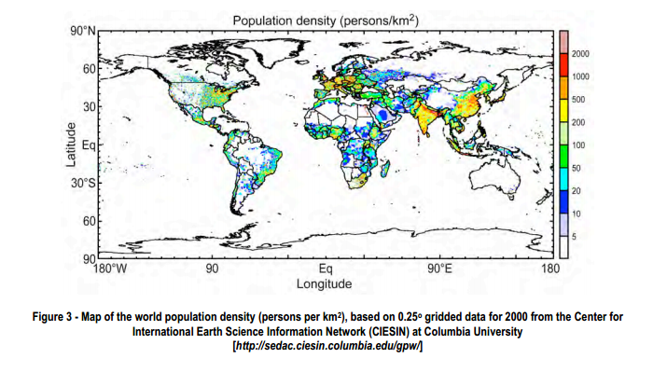

Slide 13
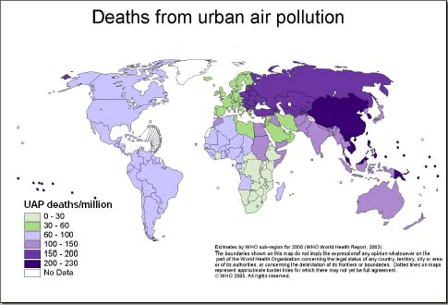

Slide 14
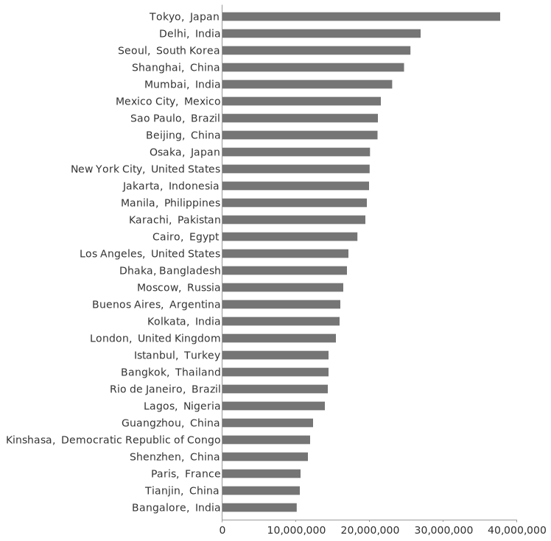

Slide 15
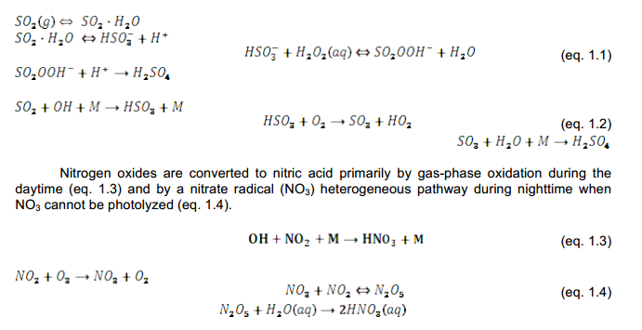

Slide 16
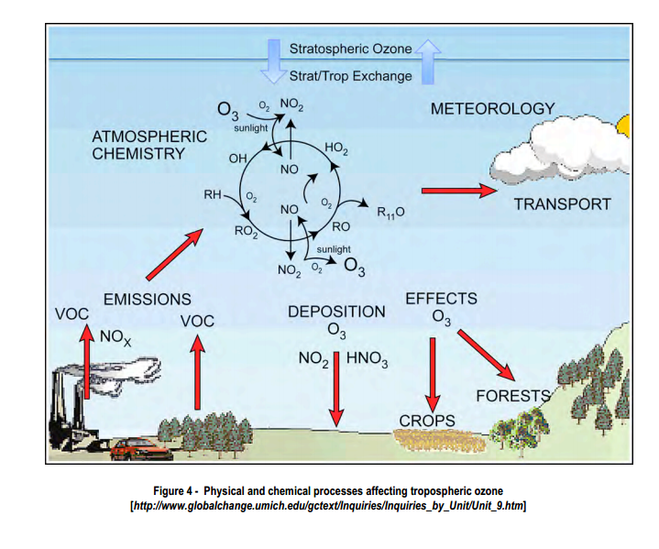

Slide 17
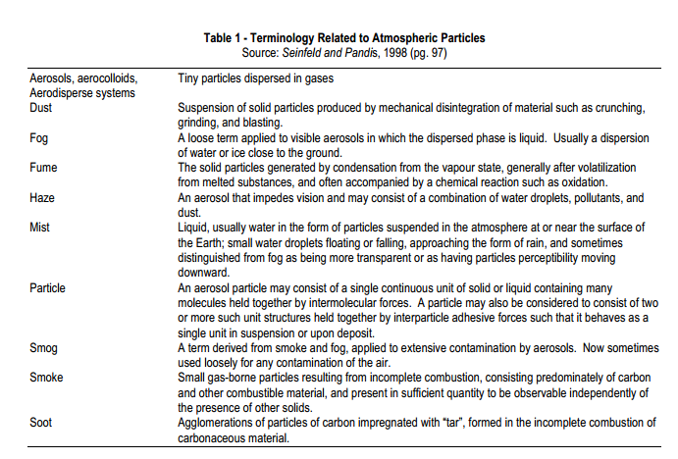

Slide 18
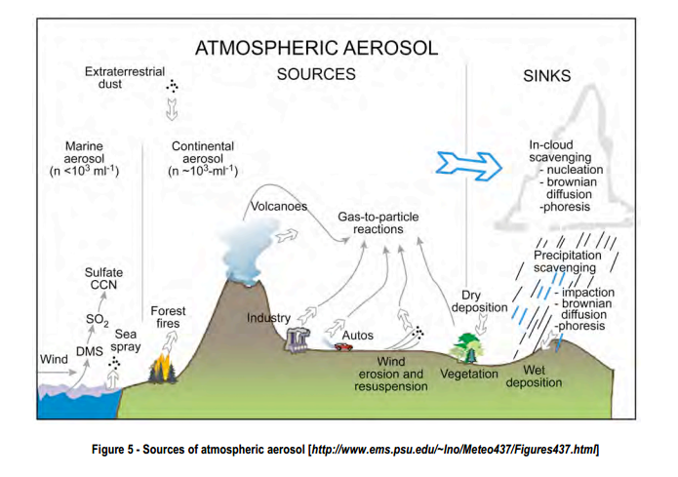

Slide 19
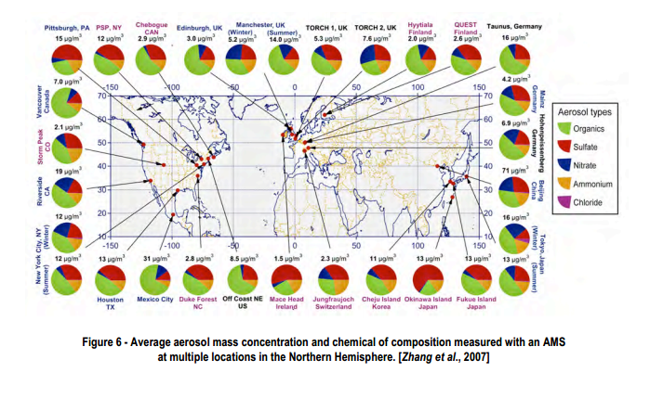

Slide 20
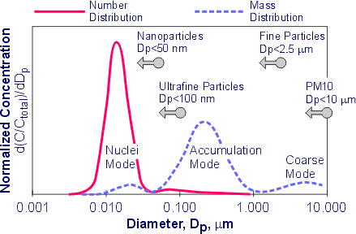
Diesel Particulate Size Distribution

Slide 21
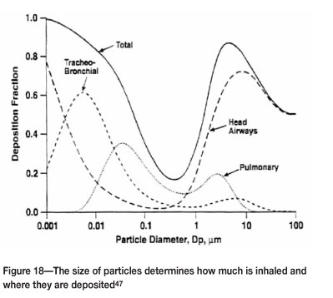

Slide 22
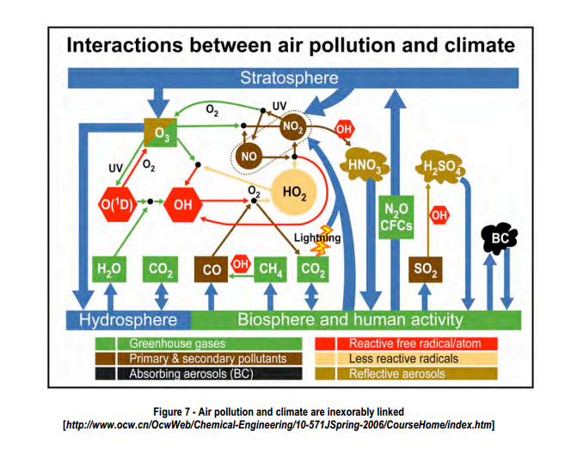

Slide 23
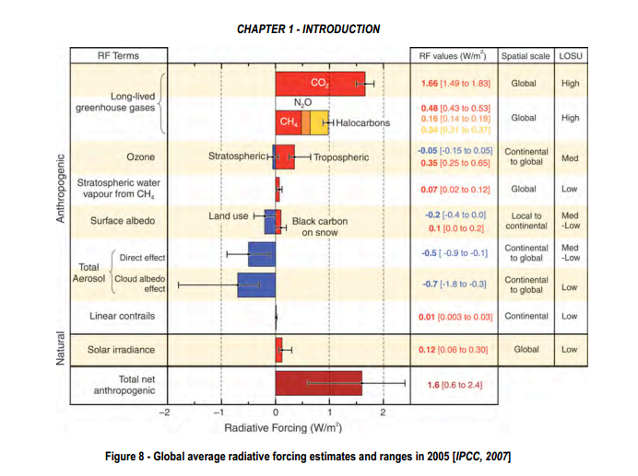

Slide 24
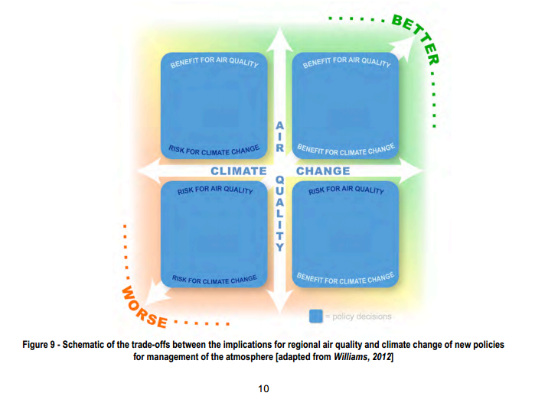

Slide 25
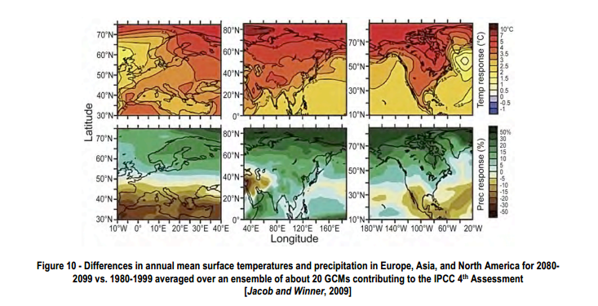

Slide 26
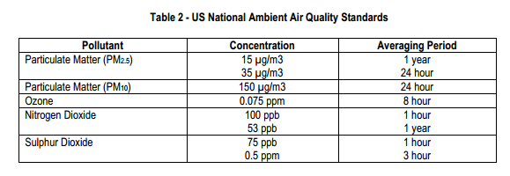

Slide 28
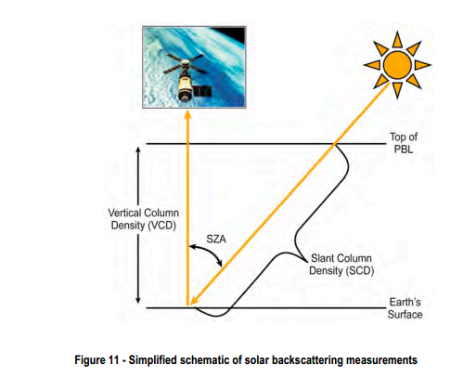
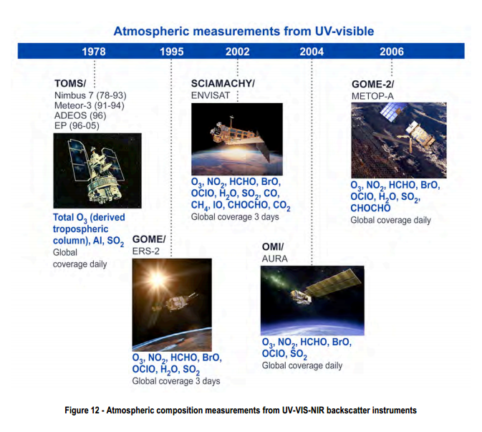
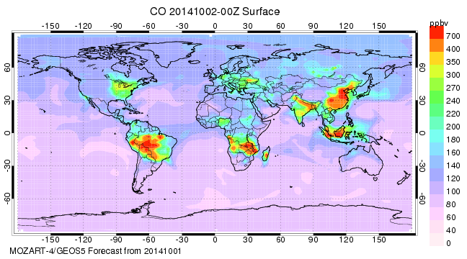

Slide 29
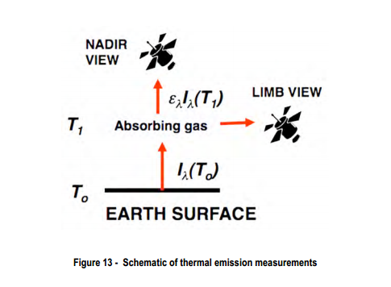
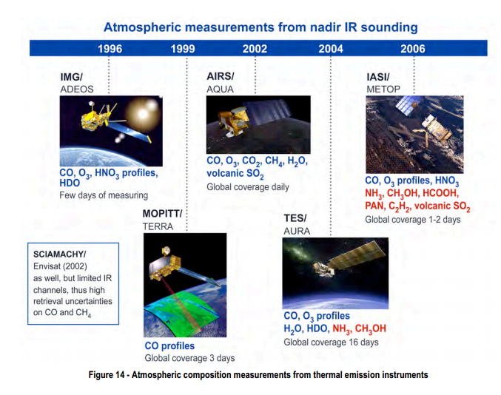
The nadir (from Arabic: نظير‎ / ALA-LC: naẓīr; meaning "opposite") is the direction pointing directly below a particular location; that is, it is one of two vertical directions at a specified location, orthogonal to a horizontal flat surface there.
The limb of the Earth is simply the horizon, or the edge of the Earth at the horizon, especially if you see it from a spacecraft.

Slide 30
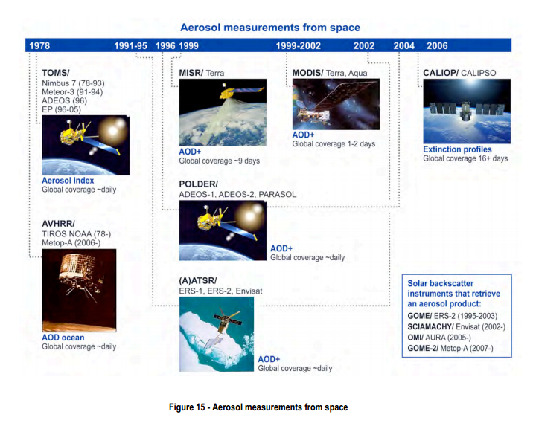

Slide 32
Lifecycle greenhouse gas emissions by electricity source.[1]
Technology | Description | 50th percentile (g CO₂/ kWh_{e})
Hydroelectric | reservoir | 4
Wind | onshore | 12
Nuclear | various generation II reactor types | 16
Biomass | various | 18
Solar thermal | parabolic trough | 22
Geothermal | hot dry rock | 45
Solar PV | Polycrystaline silicon | 46
Natural gas | various combined cycle turbines without scrubbing | 469
Coal | various generator types without scrubbing | 1001

Slide 33
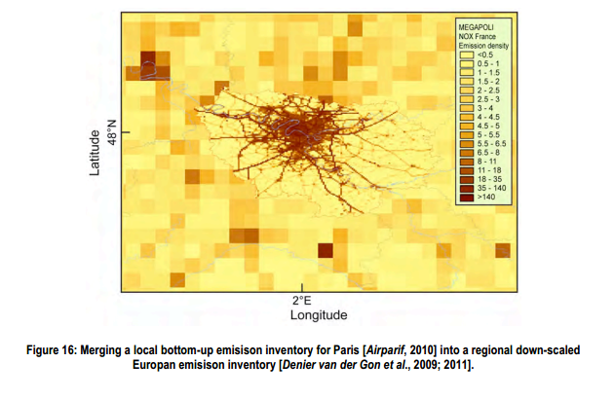

Slide 34
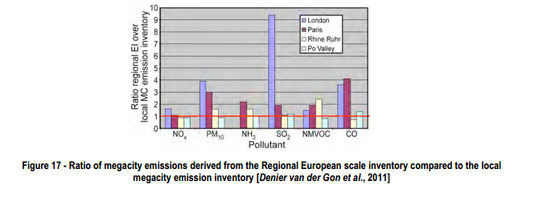

Slide 35
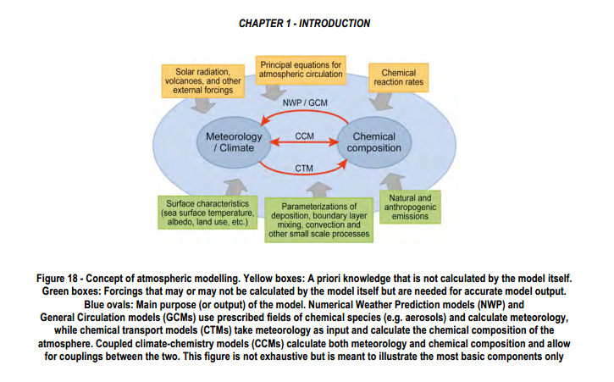

Slide 36
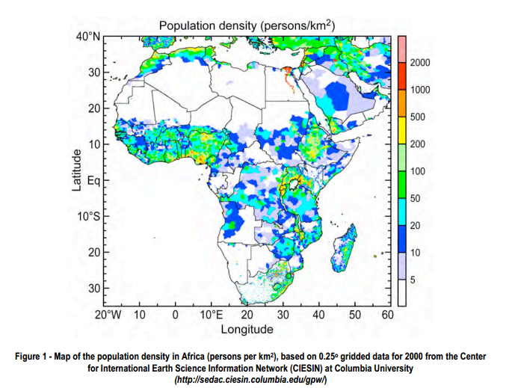

Slide 37
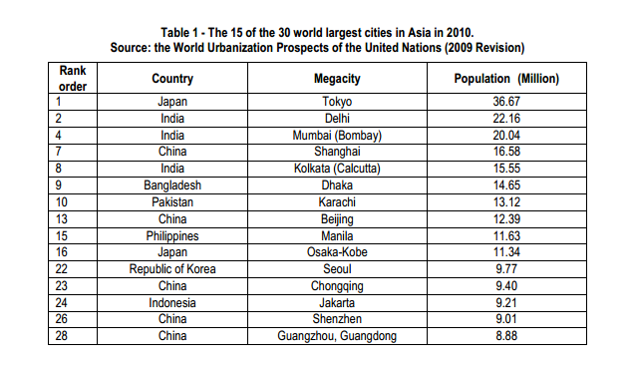

Slide 38
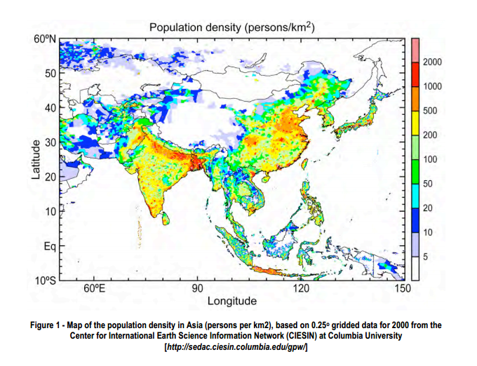

Slide 39
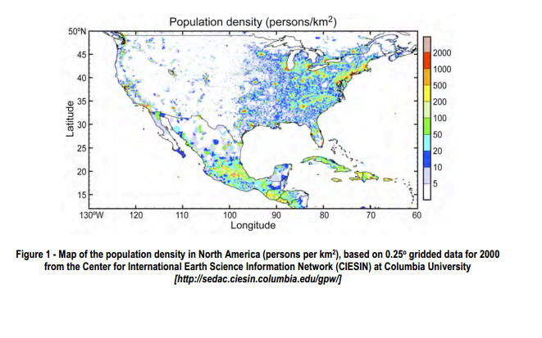

Slide 40
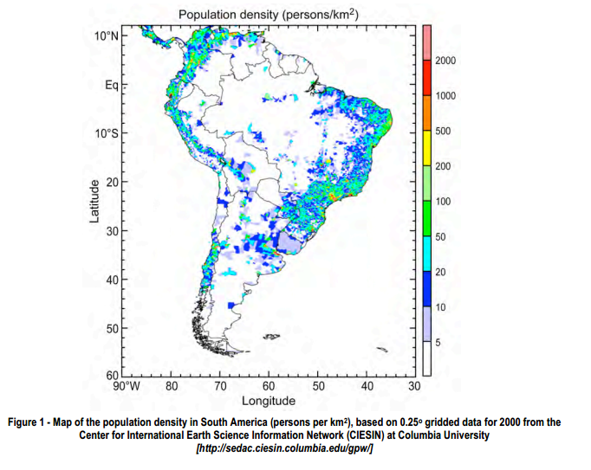

Slide 41
