Slide 1
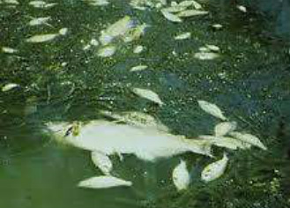
Why removing nutrients from sewage?
NH₃ – toxicity
Oxygen depletion (ammonium oxidation)
Eutrophication →Algal blooms (P & N)
Toxic algae
Dead biomass → Oxygen depletion
pH increase
Smell
Nitrate → blue baby syndrome

Slide 2
1. N-removal

Slide 4
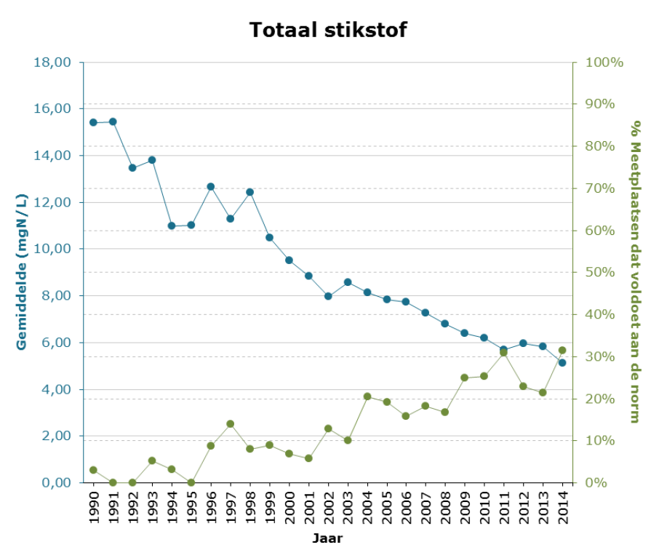

Slide 5
NO₃⁻ (+V)
O₂
COD, ..
NO₂⁻ (+III)
NO₂⁻ (+III)
COD, ..
NO (+II)
COD, ..
N₂O (+I)
O₂
COD, ..
(NH₂OH)
N₂ (0)
N-org
NH₄⁺ (-III)
Hydrolysis
Nitrification
Denitrification

Slide 6
Nitrification
- III + III
AOB
(AOA)
6 e⁻
‘nitritation’
+ III + V
NOB
2 e⁻
‘nitratation’
- III + V
8 e⁻

Slide 7
Nitrification: autotrophic
4.57 mg O₂/mg N → 4.33 mg O₂/N
NO₃⁻
95%
NH₄⁺
HCO₃⁻
5%
New biomass (CH_{1.4}O_{0.5}N_{0.2})
heterotrophs nitrifiers

Slide 8
Nitrification: oxygen demand
COD * Fb * Y_{COD} * 0.05

Slide 9
Nitrification: inhibition
pH !

Slide 10
question
NO₃⁻ (+V)
O₂
COD, ..
NO₂⁻ (+III)
NO₂⁻ (+III)
COD, ..
NO (+II)
COD, ..
N₂O (+I)
O₂
COD, ..
(NH₂OH)
N₂ (0)
N-org
NH₄⁺ (-III)
Hydrolysis
Nitrification
Denitrification

Slide 11
NO₃⁻ (+V)
O₂
COD, ..
NO₂⁻ (+III)
NO₂⁻ (+III)
COD, ..
NO (+II)
COD, ..
N₂O (+I)
O₂
COD, ..
(NH₂OH)
N₂ (0)
N-org
NH₄⁺ (-III)
Hydrolysis
Nitrification
Denitrification

Slide 12
Aerobic (O₂)
Anoxic (NO₃⁻ ; no O₂)
Anaerobic (no NO₃⁻ ; no O₂)
Denitrification in a WWTP:
facultative aerobic bacteria

Slide 13
2 ways of COD oxidation:
NO₃⁻
Denitrification (5 mol e⁻ / mol N)
e⁻
COD
e⁻
O₂
+ V 0
- 2700 kJ/mol C
- 2880 kJ/mol C

Slide 14
COD
(Organic compounds + O₂ → CO₂ + H₂O)
NOD
(NH₄⁺ + O₂→ NO₃⁻)
NOE
(Organic compound + NO₃⁻ → N₂)
NOE = how much COD is needed to denitrify the nitrate (or nitrite)?
5 mol e⁻/mol N
32 g COD/mol COD
= 20/7 g NOE per 1 g NO₃⁻-N
4 mol e⁻/mol COD
14 g N/mol N

Slide 15
A
COD + O₂→ CO₂
NH₄⁺ + O₂ → NO₃⁻
COD_{extra} + NO₃⁻→ N₂

Slide 16
B
Recycle ratio: R = (Q_{R} + Q_{R’}) / Q

Slide 17
B
Q+Q_{R}+Q_{R’} (2)
Q (1)
1 NH₄⁺
Q (1)
0.5 NO₃⁻
1 NH₄⁺ → 1 NH₄⁺
1 NH₄⁺ → 1 NO₃⁻
0.5 NO₃⁻→ 0.25 N₂
nitrification
denitrification
Q_{R} + Q_{R’} (1)
O₂
0.5 NO₃⁻
Recycle ratio: R = (Q_{R} + Q_{R’}) / Q = 1

Slide 18
B
Q+Q_{R}+Q_{R’} (5)
Q (1)
1 NH₄⁺
Q (1)
0.2 NO₃⁻
1 NH₄⁺ → 1 NH₄⁺
1 NH₄⁺ → 1 NO₃⁻
0.8 NO₃⁻→ 0.4 N₂
nitrification
denitrification
Q_{R} + Q_{R’} (4)
O₂
0.8 NO₃⁻
Recycle ratio: R = (Q_{R} + Q_{R’}) / Q = 4

Slide 19
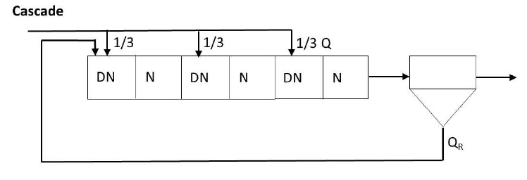
C
1/6 NO₃⁻
1/3 NH₄⁺
1/3 NO₃⁻
1/6 NO₃⁻

Slide 20
D
NH₄⁺
NO₃⁻
aeration
(nitrification)
no aeration
(denitrification)

Slide 21
question

Slide 22
NO₃⁻ (+IV)
O₂
COD, ..
NO₂⁻ (+III)
NO₂⁻ (+III)
COD, ..
NO (+II)
50%
COD, ..
N₂O (+I)
O₂
COD, ..
(NH₂OH)
N₂ (0)
‘Anaerobic ammonia oxidation’ (Anammox)
50%
N-org
NH₄⁺ (-III)
Hydrolysis
Nitrification
Denitrification

Slide 23
SHARON
ANAMMOX
NH₄⁺ + O₂ → NO₂⁻
NH₄⁺ + NO₂⁻ → N₂
CANON, OLAND, …
2NH₄⁺ + O₂ → N₂

Slide 24
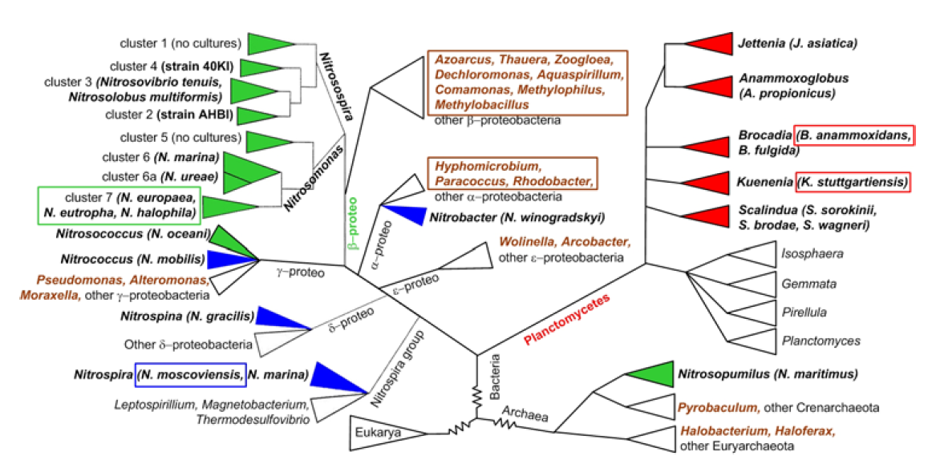
Nitritation (NH₄⁺ + O₂ → NO₂⁻) Denitrification (NO₃⁻ → N₂)
Nitration (NO₂⁻ + O₂→ NO₃⁻) Anammox (NH₄⁺ + NO₂⁻ → N₂)

Slide 25
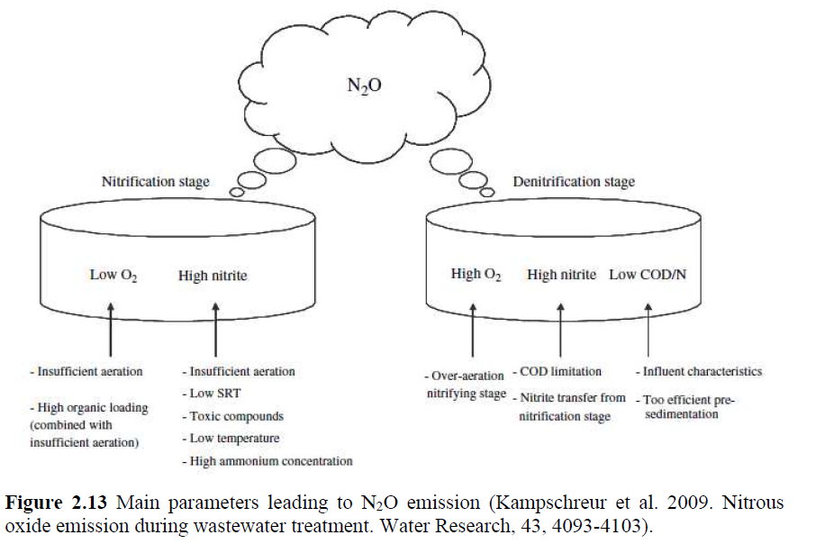

Slide 26
NO₃⁻ (+V)
O₂
COD, ..
NO₂⁻ (+III)
NO₂⁻ (+III)
COD, ..
NO (+II)
COD, ..
N₂O (+I)
O₂
COD, ..
(NH₂OH)
N₂ (0)
N-org
NH₄⁺ (-III)
Hydrolysis
Nitrification
Denitrification

Slide 27
break

Slide 28
2. P-removal

Slide 29
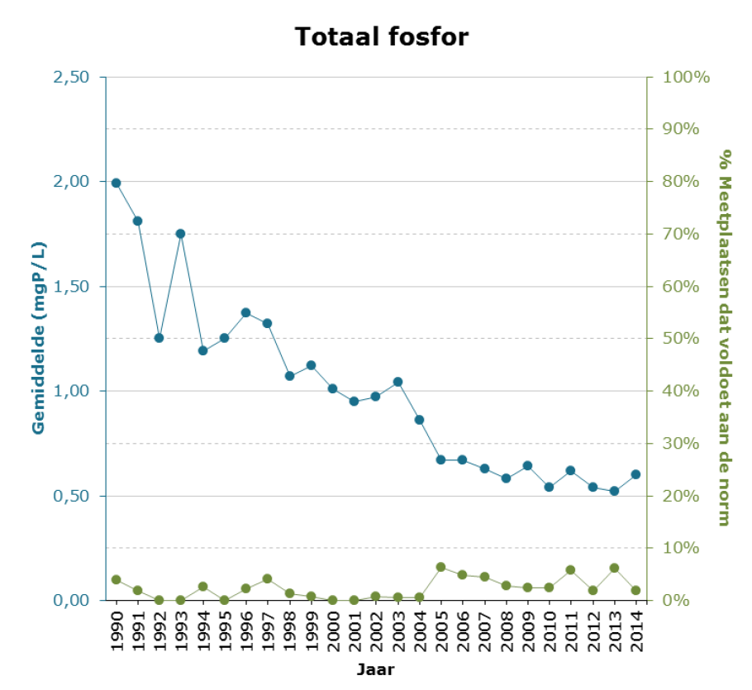

Slide 30
P-removal
Precipitation of P
Biological P removal

Slide 31
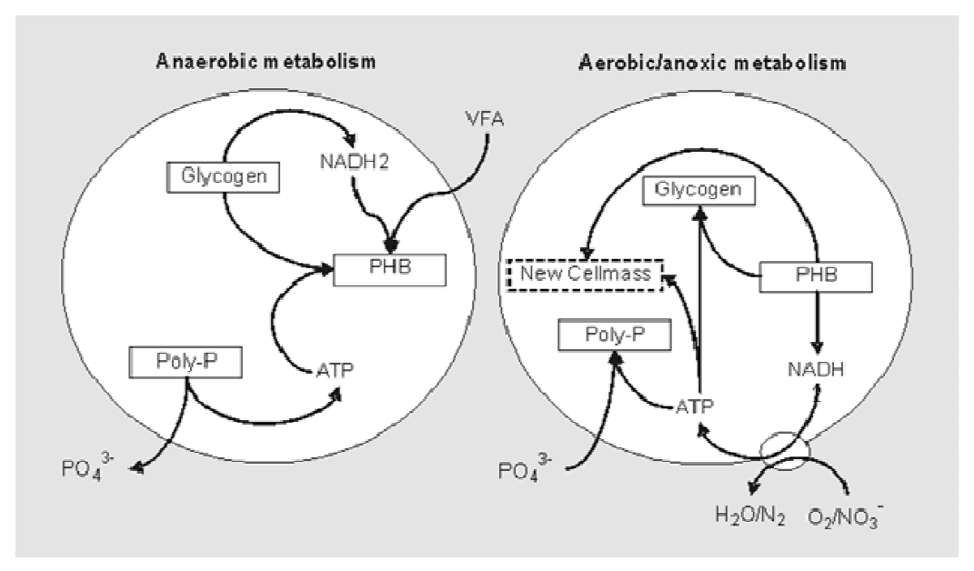
No O₂ !
No NO₃⁻ !

Slide 33
10 g CDW microbial biomass:
2.5 g CDW PAO + 7.5 g CDW other
(0.6 g P ; 24% P) (0.15 g P ; 2% P)
Wastewater
2.5 g CDW PAO 7.5 g CDW other +0.25 VFA COD_{sorbed}
(0.475 g P) (0.15 g P)
anae rob i c
0.75 g slow COD
0.25 g VFA COD
1 g bCOD
0.030 g P
0.125 g P excreted
+ 0.030 g P 0.75 g slow COD
O₂
2.5 + 0.1 g CDW PAO 7.5 + 0.3 g CDW other
(0.624 g P ; 24% P) (0.156 g P ; 2 % P)
0.4 g CDW
0.030 g P

Slide 34
question

Slide 35
Biological P-removal
COD oxidation
No nitrification
No denitrification

Slide 36
NO₃⁻
Sludge + some NO₃⁻
Biological P-removal
COD oxidation
Nitrification
Denitrification

Slide 37
Sludge
No NO₃-
NO₃⁻
Sludge + some NO₃⁻
Biological P-removal
COD oxidation
Nitrification
Denitrification

Slide 38
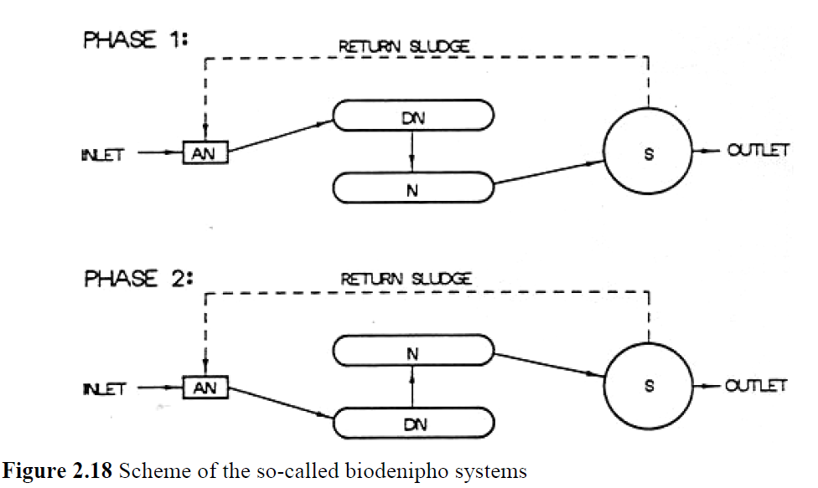

Slide 39
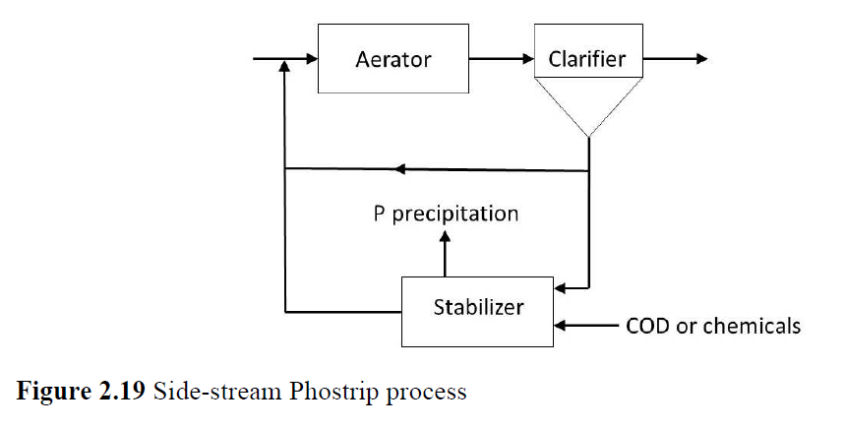
Biological release of P in anaerobic stabilizer
Precipitation of P

Slide 40
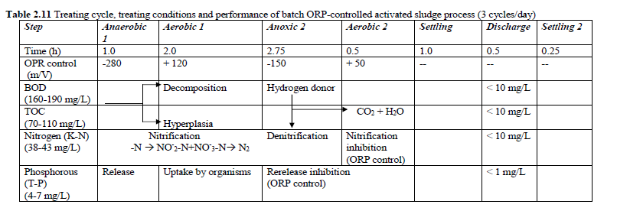
SBR

Slide 41
No lecture tomorrow!
Next week 7/10

