Slide 1
Urban and Indoor air pollution
Task: presentation

Slide 2
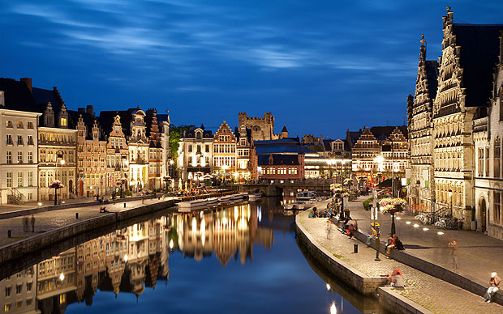

Slide 3
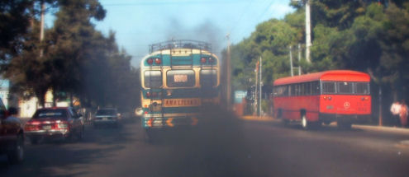
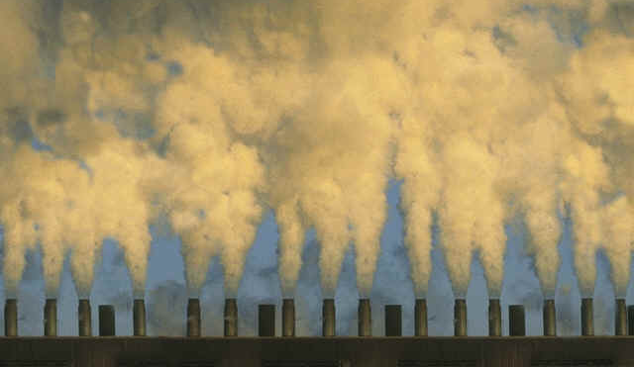

Slide 4
Task
Check the literature about indoor and outdoor air pollution research conducted in your home country (or neighboring country) via “Web of knowledge” (https://webofknowledge.com), WHO-reports, US-EPA, EEA…)
Check if air monitoring is conducted in your country, try to contact the responsible agency for information (kind of pollutants, pollutant concentration levels, legislation)

Slide 5
Task
Compare the results that you have found from your home country to the situation in Belgium:
-Compare concentration levels of pollutants ( indoor and outdoor environments) with those observed in Belgium (Belgium: IRCELINE: http://www.irceline.be/)
-Legislation on air pollution: compare the differences between Belgium and your country
-Think about specific activities conducted in indoor environment (type of cooking, use of repellents, incense smoke) or outdoor environments (burning of waste) ? Discuss what type of compounds might be emitted from those activities.

