Slide 1
URBAN AND INDOOR AIR POLLUTION TASK PRESENTATION PARTICULATE MATTER POLLUTION IN RWANDA
HABIMANA VALENS
Master Student, Ghent University

Slide 2
Outline
Introduction
PM pollution in Kigali City
Sources of PM in Kigali City
Impacts of PM Pollution
Progress made to reduce the pollution
Comparison of current situation with Belgium situation

Slide 3
Introduction
Rwanda, a land of thousand hills is the most densely populated country in Africa.
it has a very large rural population, but a high urbanization rate
Kigali is the Capital, Located in the heart of Rwanda
More than one million people, 10.8% of total population.
Rate of urbanization of 4.5 %.

Slide 4
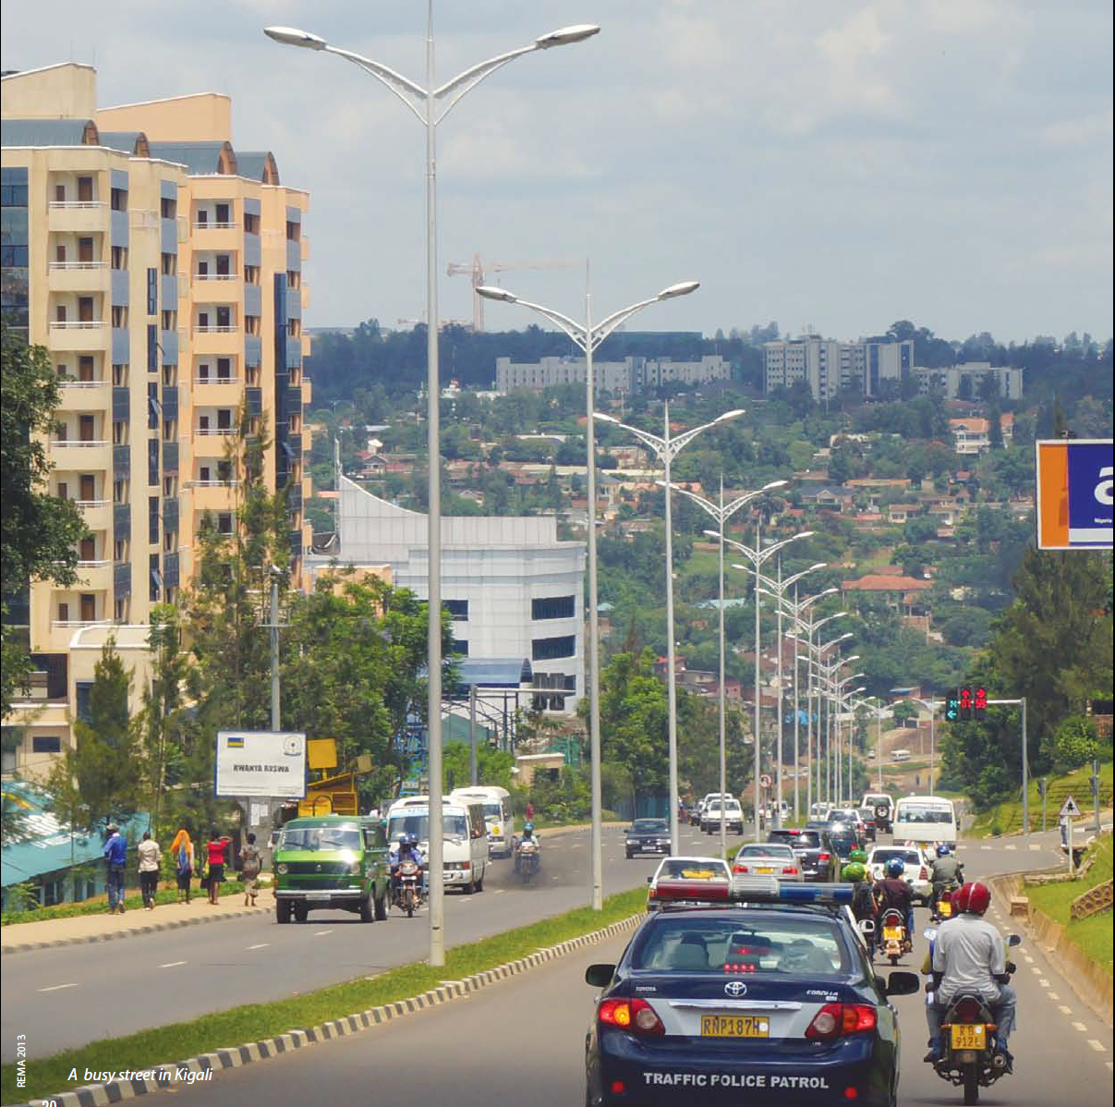
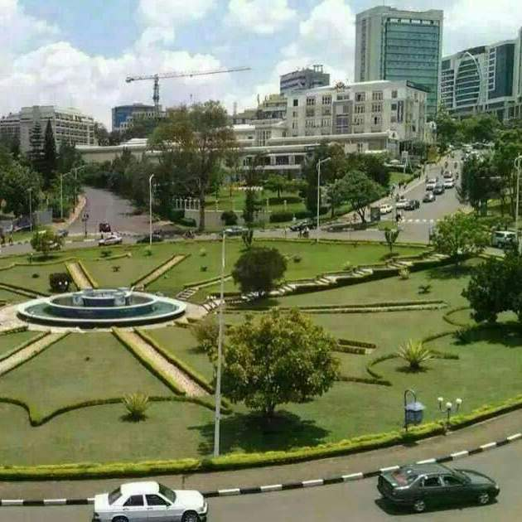
Kigali, the capital City of Rwanda, and built on hills and valleys.

Slide 5
particulate matter pollution in Kigali
Analyzing the air quality of Kigali is one part of the ReCCiR Project
measurements were taken by a mobile laboratory
a suction device of the mobile laboratory at 1.50 m above ground level
The maximum driving speed was 30 km/h along streets.
different times of the day: 9 am-10 am; 4 pm-5 pm and 2am-3 am

Slide 6
map of Kigali city showing the measuring route (red line) and the red dots showing fixed air quality station

Slide 7
Mean PM10 concentration for day time

Slide 8
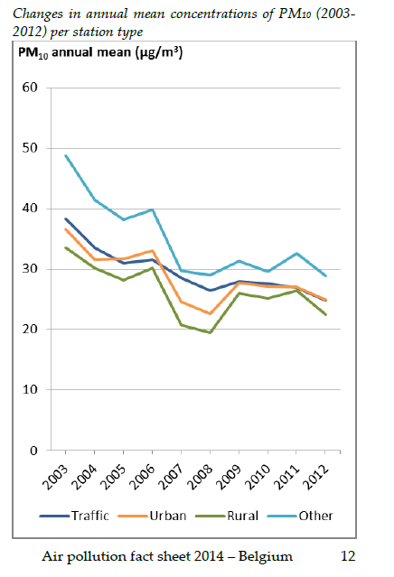
Belgium situation

Slide 9
Mean PM10 for the night time hours

Slide 10
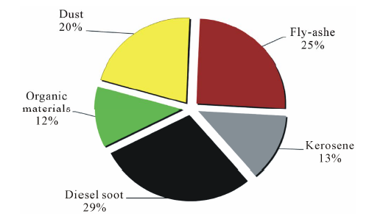
SOURCES OF THE POLLUTION
Using SEM conclusions on origin is obtained

Slide 11
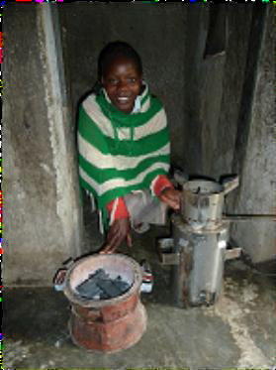

Slide 12
Impact of particulate matter pollution
indoor air pollution caused by solid fuel use accounted for 5.8% of the Rwandan national burden of disease (WHO 2007).
In Rwanda, respiratory disease accounts for 34% of new visits to health centres, no doubt caused mostly by indoor pollution from cooking (Ruxin 2011).
Respiratory infections are the leading cause of child deaths in Rwanda (MINISANTE 2012), many of which may be the result of indoor air pollution (Young and Khennas 2003).

Slide 13
Progress made to reduce the pollution
Organic Law on the Environment does not allow activities that damage air quality (RoR 2005)
REMA oversees the matter of air pollution in Rwanda and monitors emissions from industries.
The RBS specifies the permissible limits for pollutants in both ambient air and emission sources. (Babijja 2012).
It also prescribes the tolerable limits for dust from factories into the air (RBS 2011).

Slide 14
Air pollution monitoring stations
Regular monitoring is necessary
Briquettes may be a better alternative(Young and Khennas 2003)
The EDPRS 2 encourages initiatives to increase the use of improved cook stoves
private sector to invest in developing the improved stove technology (MINECOFIN 2013).

Slide 15
Rwanda situation VS Belgium situation
 | Rwanda | Belgium
Sources | Diesel soot, fly ash, dust, kerosene and organic material | Energy use , road transport , industry, sea salt, agriculture
Concentration | PM10: 650μg/m3 | PM10 : 25 μg/m3 in2012
Exposure | Difficult to estimate | 15.9% in 2012
Data on emission | Difficult to obtain | EUEI submitted under LRTAP, and data submitted under EUNEC Directive
Pollutants trend | Increased | Decreased
REGULATION | Organic law | European legislation
Institutions | REMA, RBS(limit) | EEA, NEC Directive(limit)

Slide 16
Conclusion
Analyzing the suspended particulate matter indicates a daily average of PM10 = 650 μg/m3 which considerably extend the critical limits of the WHO.
the suspended PM within the urban atmosphere pose an innate hygienic endangerment for the population of Kigali.
This situation is accelerated man made pollution due to the usage of aged diesel vehicles and the combustion of biomass.

